Slide 1



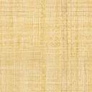
Verifying and Optimizing a Profile in KODAK Proofing Software in KPS 10

Slide 2

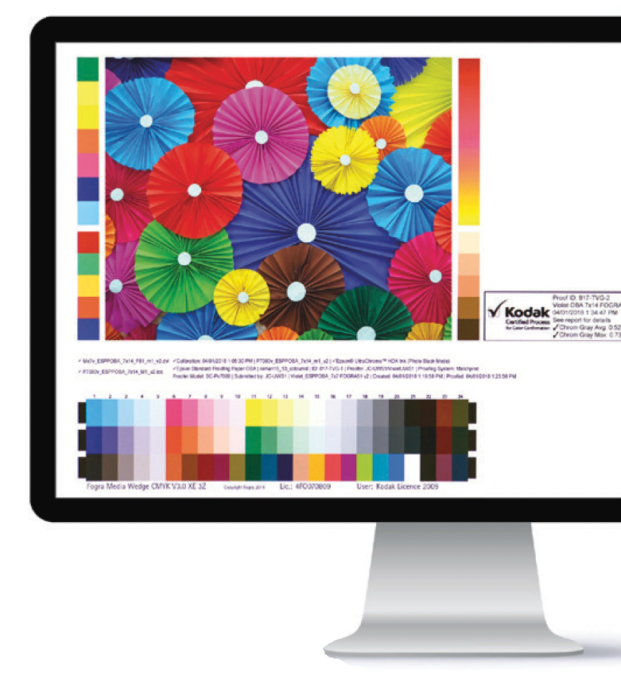
When do you need Verify a Profile?
After creating a custom media configuration
Anytime to check for accuracy of the proof’s color match
To verify for G7 compliance
For information on Creating Custom Media Configurations for KPS MPI Software: https://workflowhelp.kodak.com/display/MPI82/Startup+Assistance+for+Custom+Media+Configurations

Slide 3

How long does it take?

Slide 4
Verifying a profile can take approximately 1 hour, depending on the type of spectrophotometer you have.
If you are using a printer with an inline spectrophotometer, all the steps can be performed remotely.
If you are using an offline spectrophotometer, additional active participation is required to measure charts.
When verifying a profile, a special Color Bar containing a profile chart (TC1617 – includes press grays) will be printed for measurement.
For all supported spectrophotometers, the profile chart is 1 page.

Slide 5

How do I prepare?

Slide 6
To prepare:
Create a custom Media Configuration and Proofer Profile using KPS v8.5 or higher.
Create a custom ICC DVL with your custom Media Configuration and Proofer Profile. The best color performance can be achieved by using an ICC DVL. You can also use Profile Pairs; but this will not yield the best color performance. (See the Instructions below, “Creating DeviceLink Profiles in KPS”)
It is best to verify the color of your new Media Configuration + DVL immediately after creating it. You can also verify the color, at any time in the future.
If you are verifying the color of an existing Media Configuration, you will need to do the following first:
  Load the proper media into the printer, ensuring that you have enough media to complete the process—including calibration.
  Ensure that you have an adequate supply of ink.
  Run a nozzle check test, and clean if needed.
  If your printer has been idle for a long time or is newly installed; it is recommended to “warm-up” the printer first. Run a series of fully inked proofs for a day or two; perform normal head cleaning cleaning cycles at the start and end of each day, and as needed. If nozzle performance is intermittent; continue the ”warm-up” for another day.

Slide 7

Setup Tips
Media – choose the right Media
  Color of Media
    Paper color – should be close as possible to the target white point.
    Check paper manuf. for compatibility with your color target. Best results with Epson Media on Epson Proofer.
    Choose the right Measurement Condition – some color targets/media require a specific measurement condition.
  Color Gamut requirements. Check paper manuf. for compatibility with your color target. Best results with Epson Media on Epson Proofer.
Media Configuration Settings tips
  30min drying time for all prints is ideal.
  Total Ink Limit should not be set too high (most Semi-Matte media types are never higher than 1.0, for P75/P95 usually not higher than 0.8)
  Paper Feed – use the new method in KPS v8.5 or higher.
  For Optimum color results create a new custom Media Configuration. Kodak Factory Media Configs are not for color-critical work.
Spectrophotometer tips
  White calibration tile should be clean.
  Spectrophotometers that require hand measurement can be frustrating and inconsistent. Recommend using an inline Spectrophotometer.
  Inline devices
    Use the White backing strip supplied by the Manufacturer.
    Ensure Matching white tile installed (White tile serial number must match the Spectro serial number).
Printer checklist:
  All nozzles should be firing/printing on a nozzle check pattern.
  Inkjet Printers that sit unused for long periods of time – should be “warmed-up” first. (see “How Do I Prepare” slide).
  Stable Ink – color might shift after changing cartridges
  Newly installed printers – must completely change out all of the installer ink kit (1 or 2 full days of printing).
Check the prints
  Ensure that all prints are not showing banding of any kind. Color patches should have consistent color across
  the patch.

Slide 8

Where are the Profiles located in KPS?

Slide 9
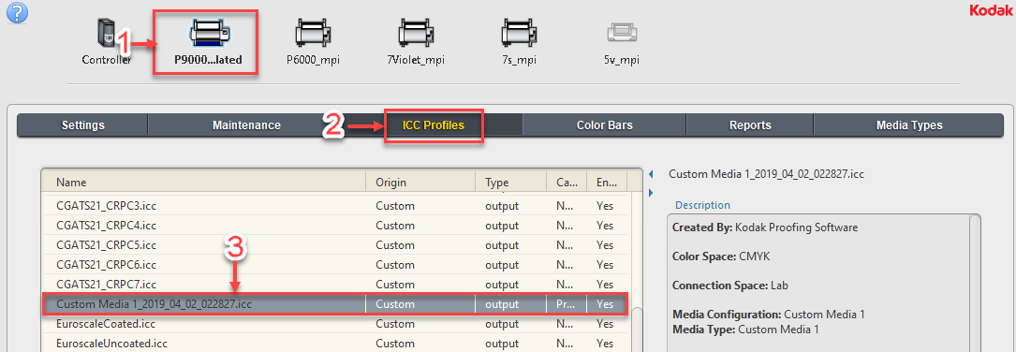
To locate the Profiles in KPS
Go to the Kodak Proofer Administrator
1. Select your Proofer by its name on top
2. Select the “ICC Profiles” Tab
3. The Profiles will be in the list
Note: All Profiles created by KPS are automatically signed for Certified Process for Color Confirmation

Slide 10
Profile Verification - Introduction
This presentation uses an Epson printer equipped with the SpectroProofer inline spectrophotometer option (which can be an automated process) as an example. The steps are similar for other printers.
Recommend Creating a Custom Media Config + ICC DVL using KPS v8.5 or higher.
KPS v10.0 or higher also uses the latest Kodak ICC profile Gray Balance correction technology, for color target data sets that contain extra gray balance information (G7TVI).

Slide 11
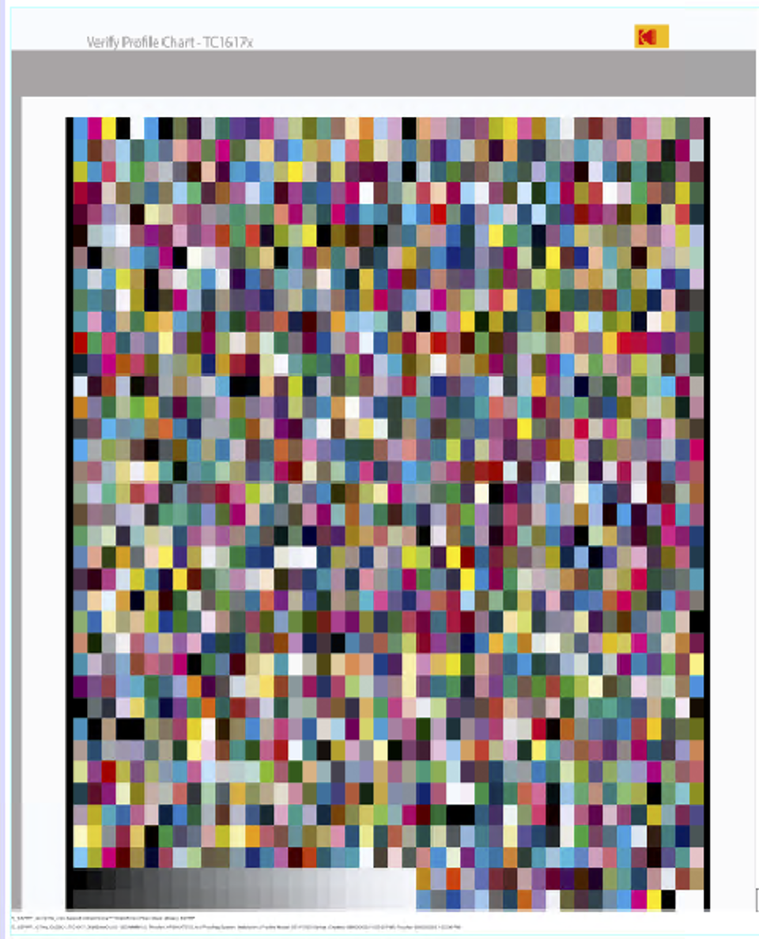
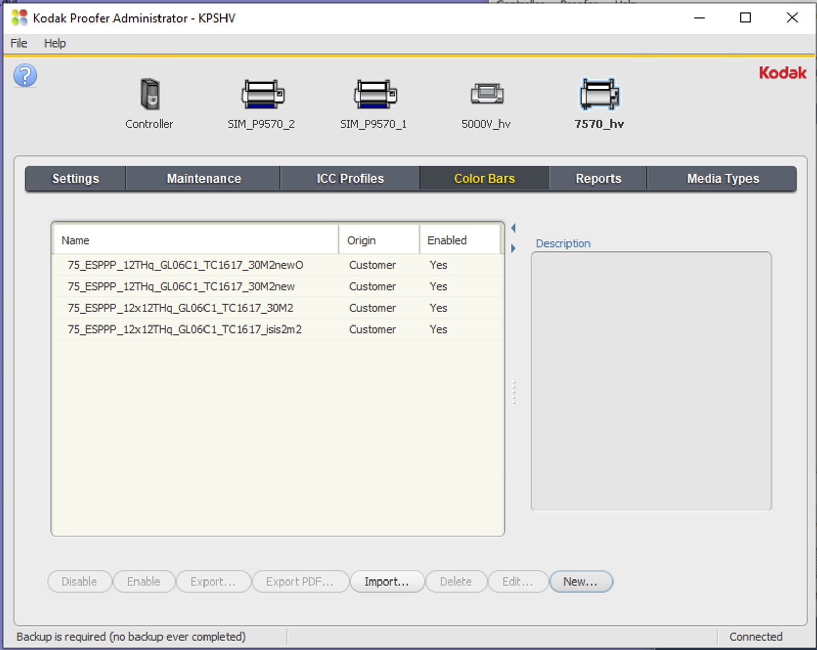
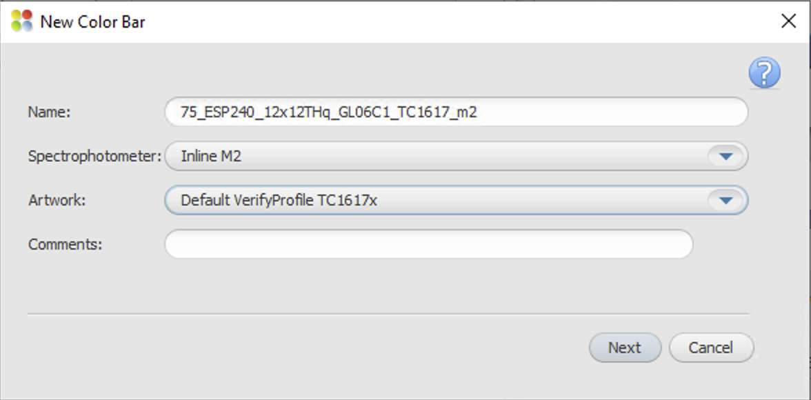
Introduction
The basic steps are:
  Create the Profile Verification chart (Color Bar= VerifyProfileTC1617x)
  Export the color bar
  Create a new Layout to use the Profile Verification Color Bar
  Output the color bar using the new layout
  Measure the color bar

Slide 12
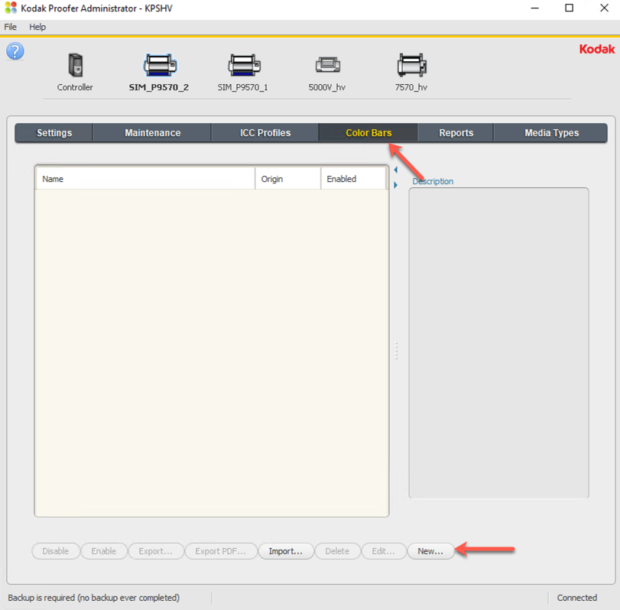
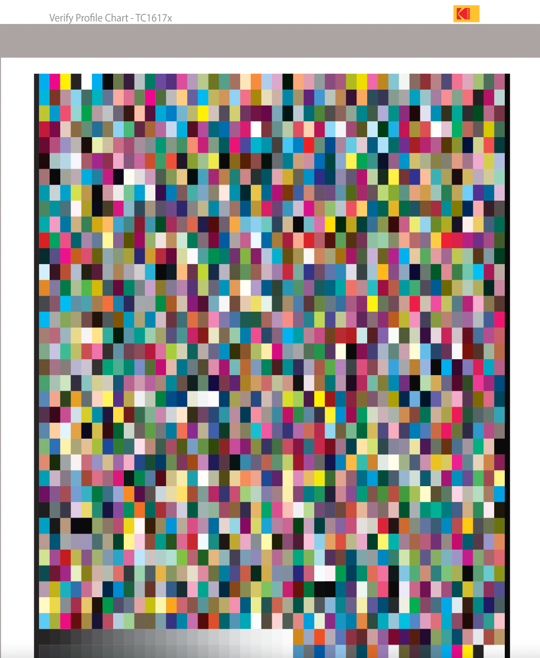
Step 1 - Create a Custom Color Bar
Launch the KPS Administrator and Click on the Color Bars Tab.
Select your Proofer by its name on top
Click on New to create a new Color Bar
Note: The Color Bar for the Profile Verification must be created from the “Default VerifyProfile TC 1617x “ Artwork

Slide 13
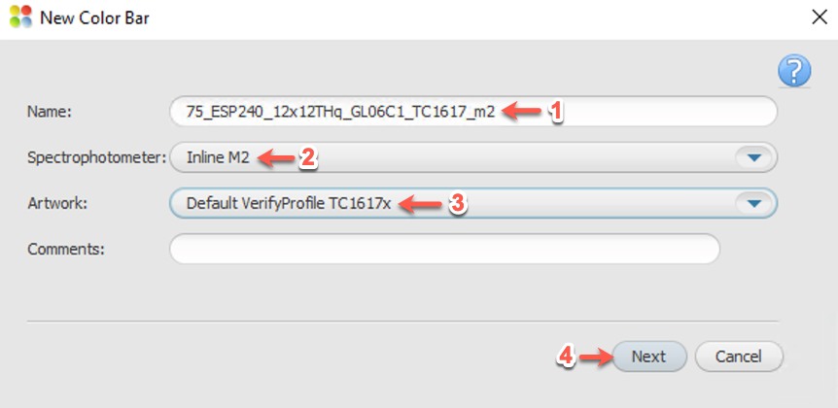
Step 2: Name the new Custom Color Bar
Name: Enter a name that describes the color bar
Spectrophotometer: Select the Spectrophotometer plus the measurement condition
Artwork: Select the “Default VerifyProfileTC1617x” Artwork Note: You must select this Artwork
Click Next

Slide 14
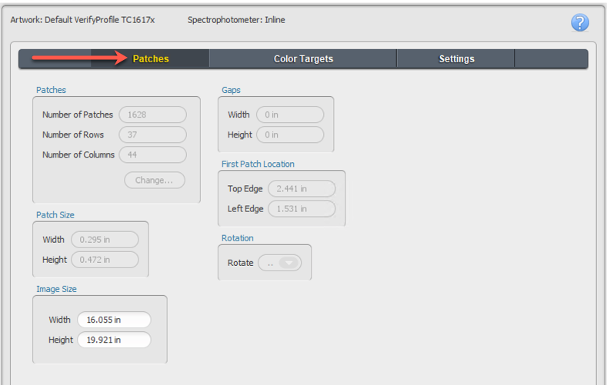
Step 3: Color Bar – Patches Tab
Leave the default Image Size settings
Click on the Color Targets Tab

Slide 15
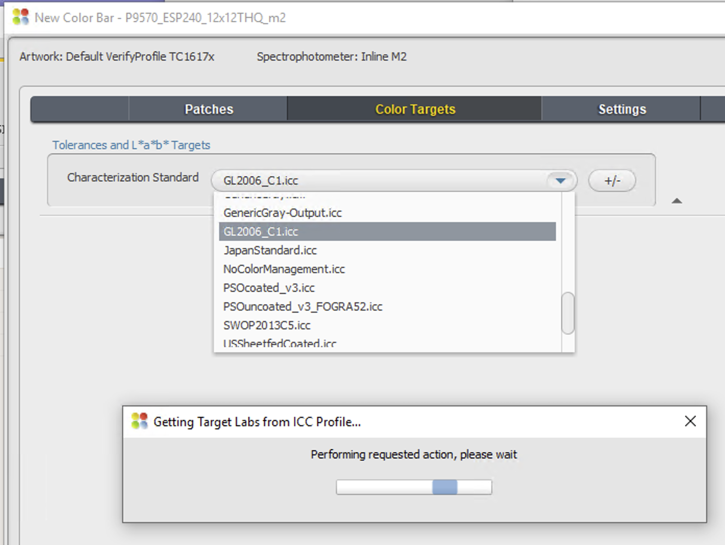
Step 4: Color Bar – Color Targets
Characterization Standard: The Target ICC Profile you are looking for may already be in the list.
  Note: If you require a different one, you can import the profile as follows:
  In the KPS Administrator
  Select your proofer name
  Select the ICC Profiles Tab
  Click the Import button

Slide 16
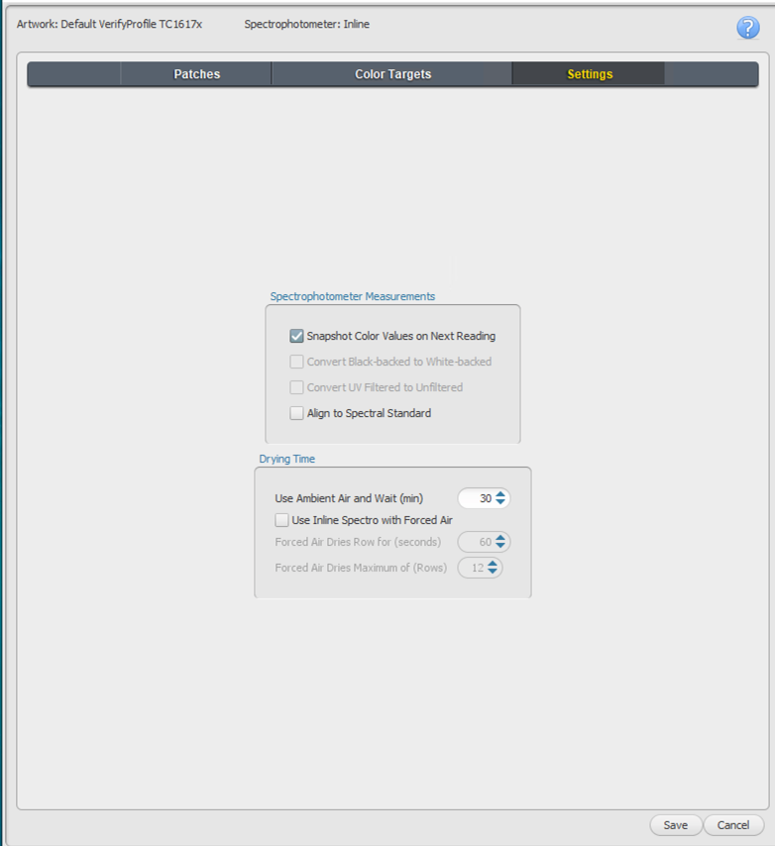
Step 5: Color Bar – Settings Tab
Leave the default settings
Click Save
Note: The settings are not applicable to the Profile Verification process.

Slide 17
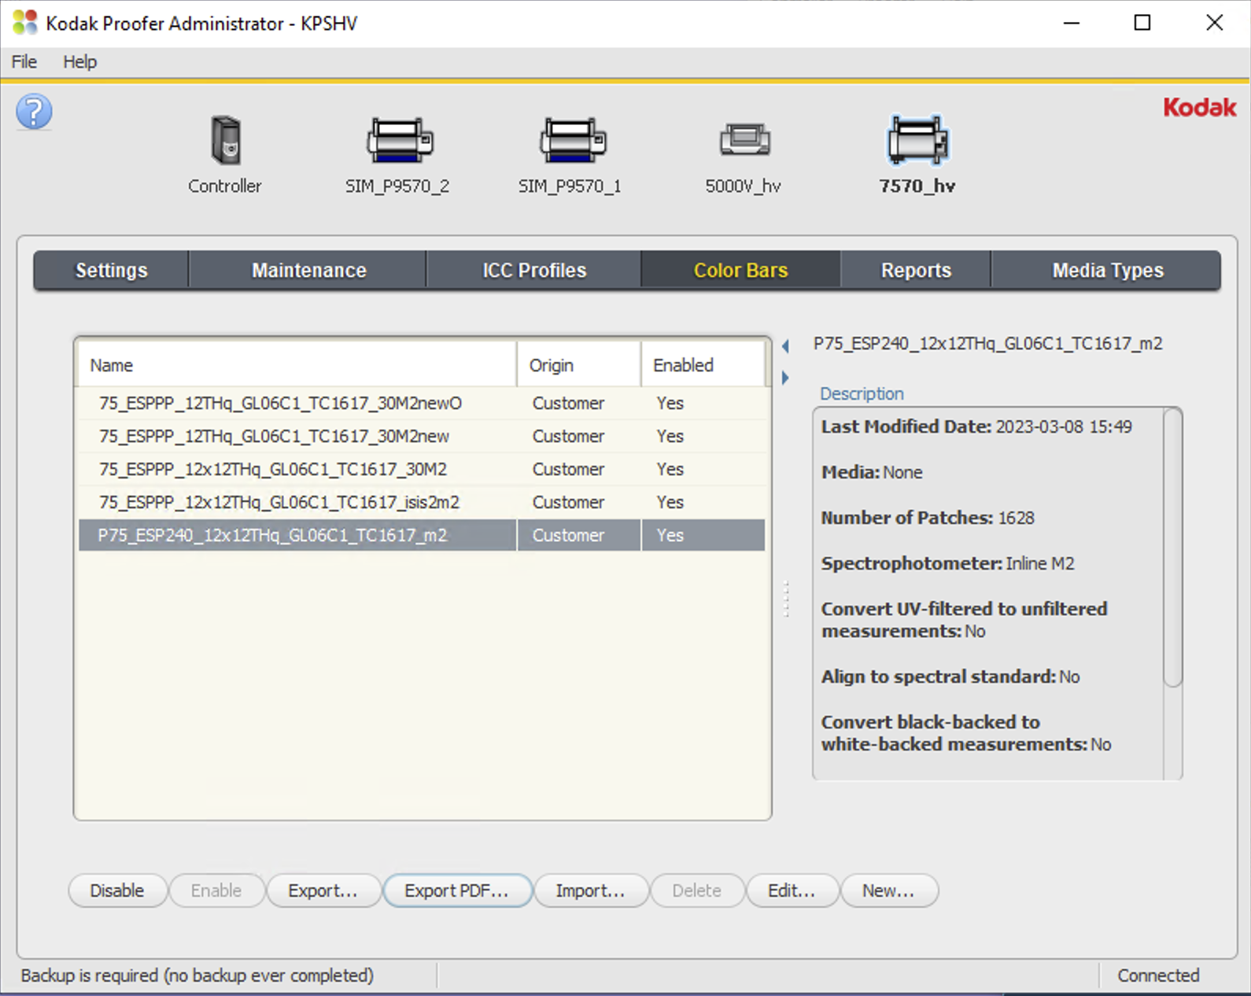
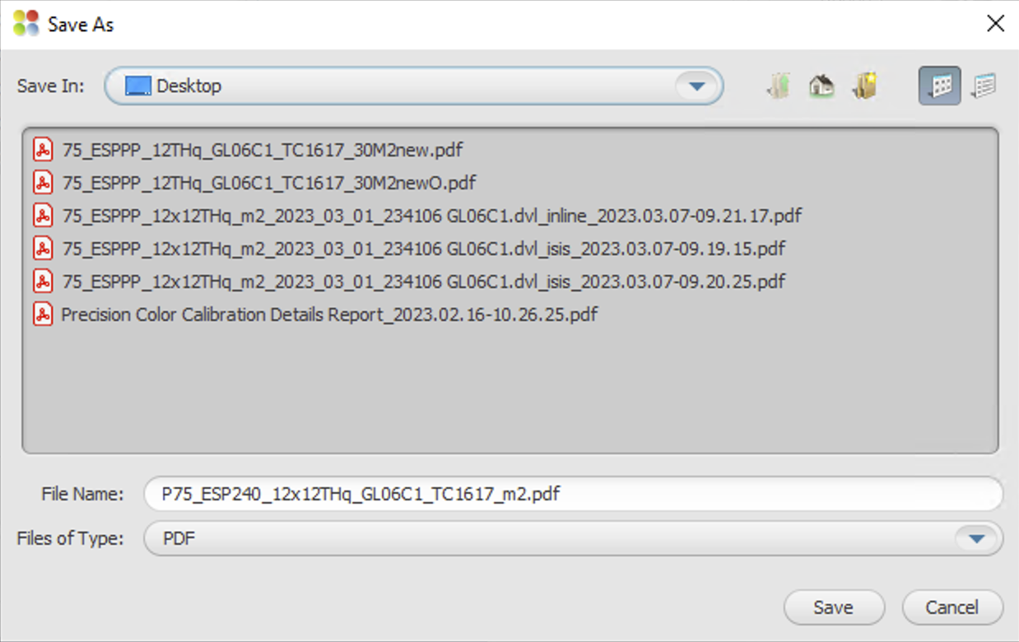
Step 6: Export the new Color Bar
Choose a convenient location, as this file is only temporary.

Slide 18
Create a new Layout to use the new Profile Verification Color Bar
From the Configure drop down, select Layouts

Slide 19
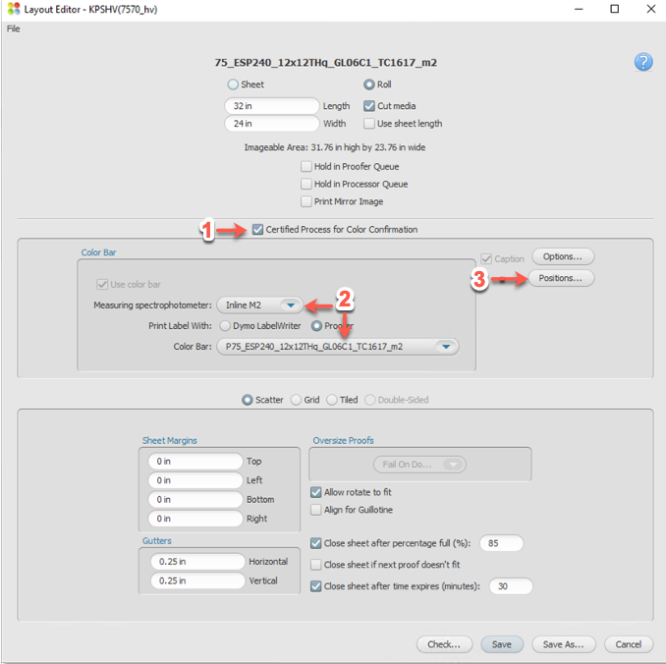
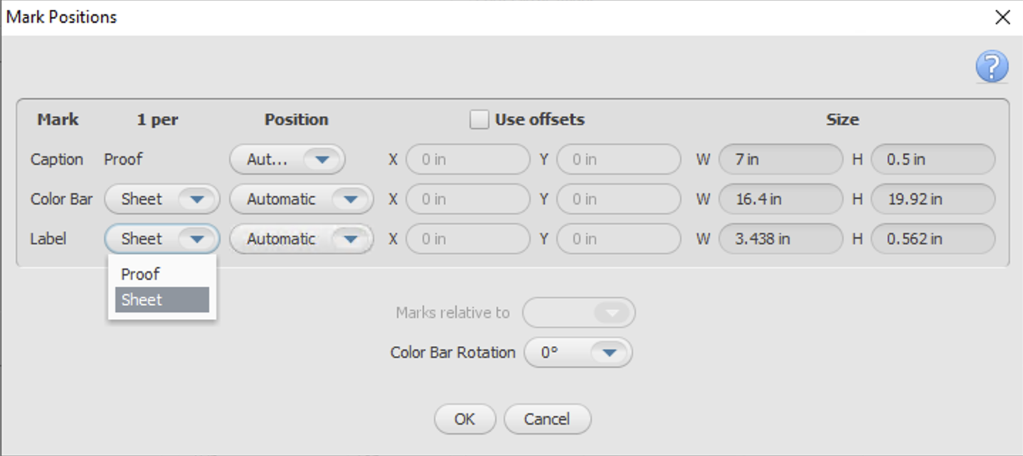
Step 1: Create a Layout to use your new Profile Verification Color Bar
Check the “Certified Process for Color Confirmation” (CPCC) box
Select your Spectrophotometer and your Color Bar Name.
Click on Color Bar “Positions…” button and change it to “Sheet” for both “Color Bar” and “Label.”

Slide 20
Process the Profile Verification Color Bar through your Workflow
Two methods:
1 - Kodak Prinergy Workflow
2 - KPS “Open Connect” Hot Folder Workflow

Slide 21
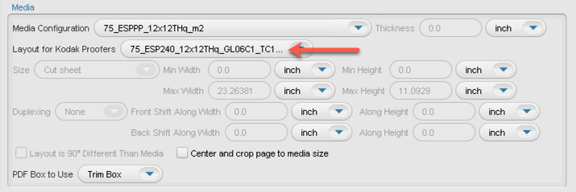
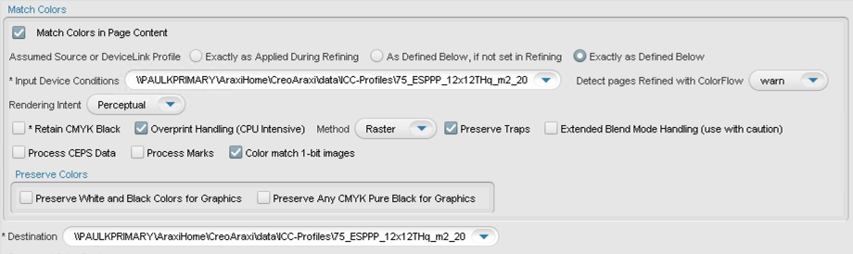
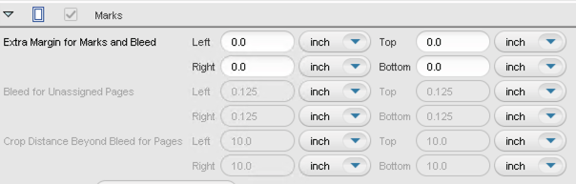
Method 1 – Prinergy Workflow
Create a new process template in Prinergy to process your new Profile Verification Color Bar
- Layout: Choose the newly created Layout from the previous step (slide 19)
- ColorConvert: Use the proofer profile and DVL profiles
Note: In the Marks section, make sure the Extra Margins for Marks and Bleed are all set to 0.0.

Slide 22
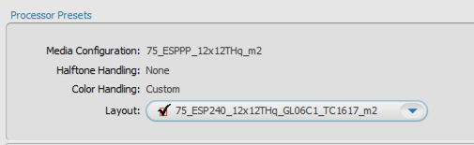
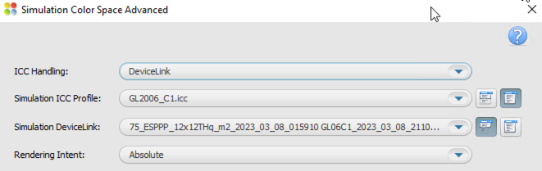
Method 2 - Open Connect
Create a new Hot Folder in KPS to use your new Profile Verification Color Bar
- Layout: Choose the newly created Layout from the previous step (slide 19)
- ICC Settings: Use the proofer profile and DVL profiles

Slide 23
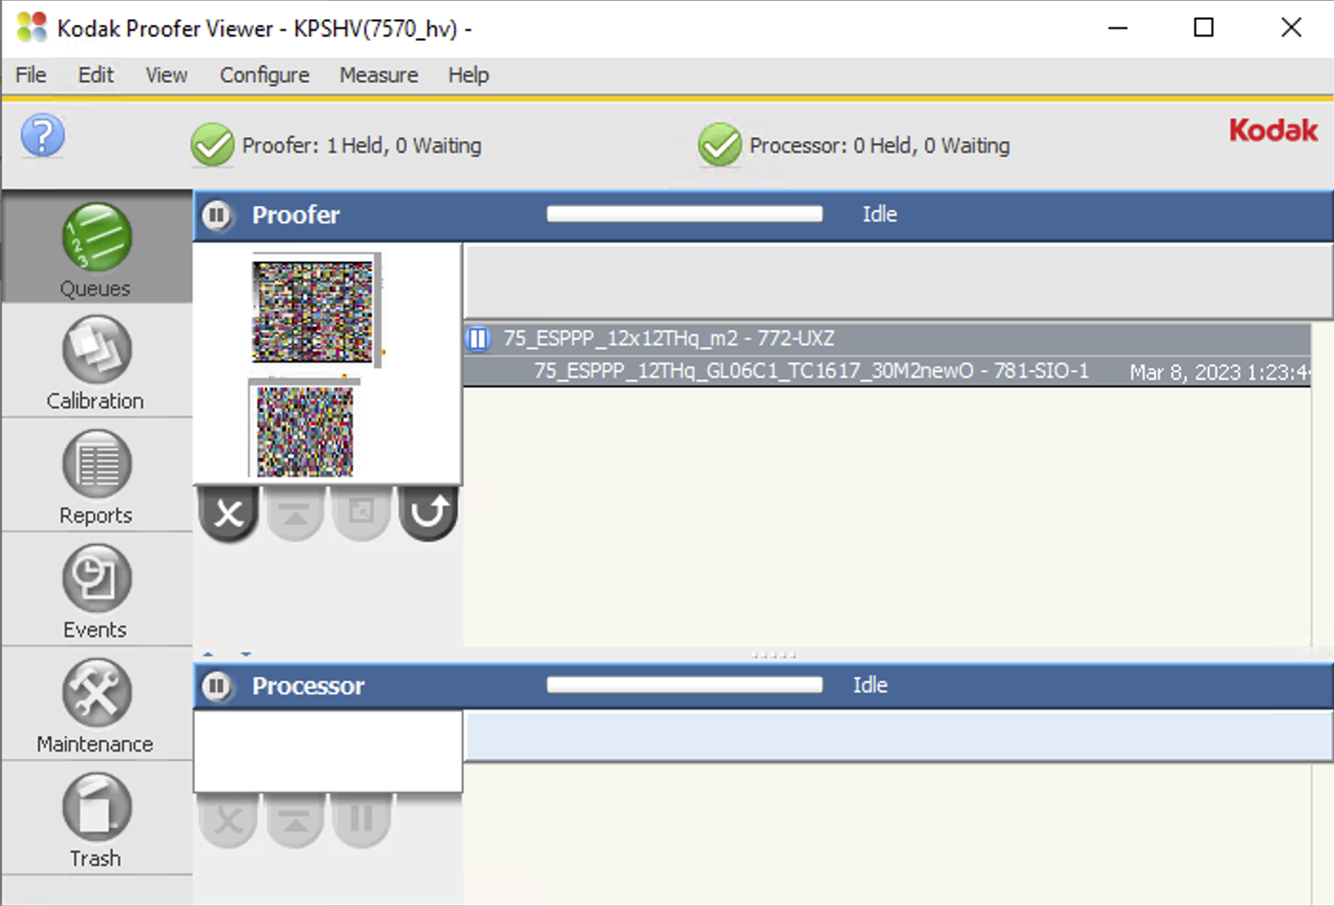
Step 2: Process the Profile Verification Color Bar through your Workflow
This step can be done using either the Kodak Prinergy Workflow or the KPS “Open Connect” Hot Folder Workflow.
In this step your DVL is applied to your new Profile Verification Color Bar.
Note:
The Profile Verification Color Bar must be the first file sent to the Layout you have created earlier.
You do NOT need to print and measure this image for the following reasons:
The page is too long for the Inline Spectro
To save ink and paper for the Off-line Spectro
After it is completed, it will automatically be in the “paused” state. Then you can delete it and proceed to Step 3 - Print the Profile Verification Color Bar.

Slide 24
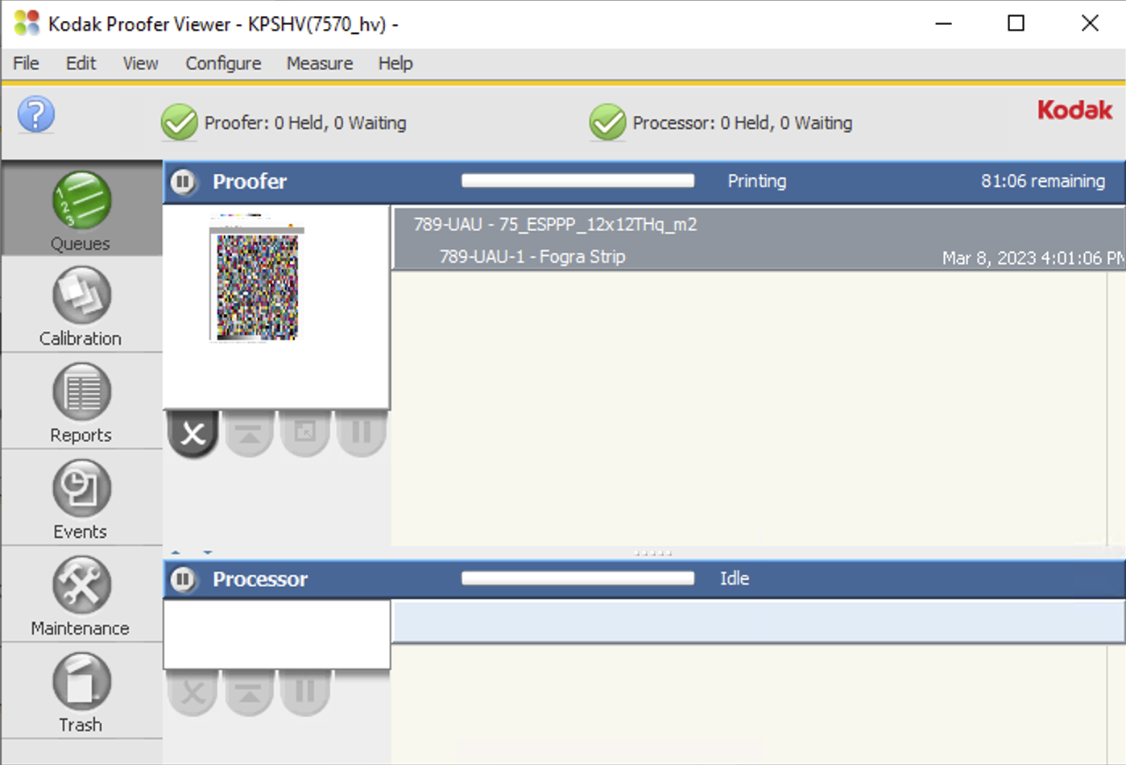
Step 3: Print the Profile Verification Color Bar
You can now Print the Color Bar using any image (recommend using a very small one to save media).
It will be convenient to save this small image for this purpose somewhere on your KPS Controller; to be used every time you want to Verify the Color of your custom setup.

Slide 25
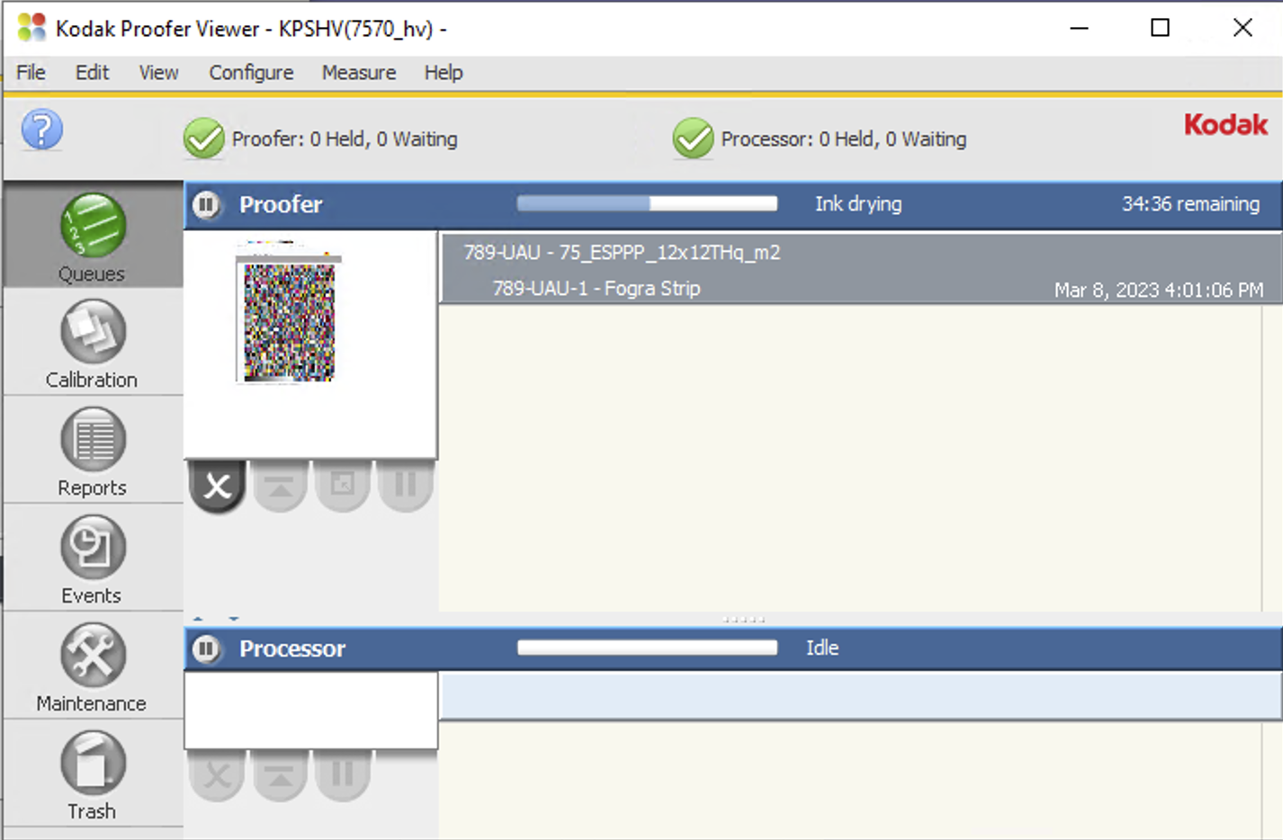
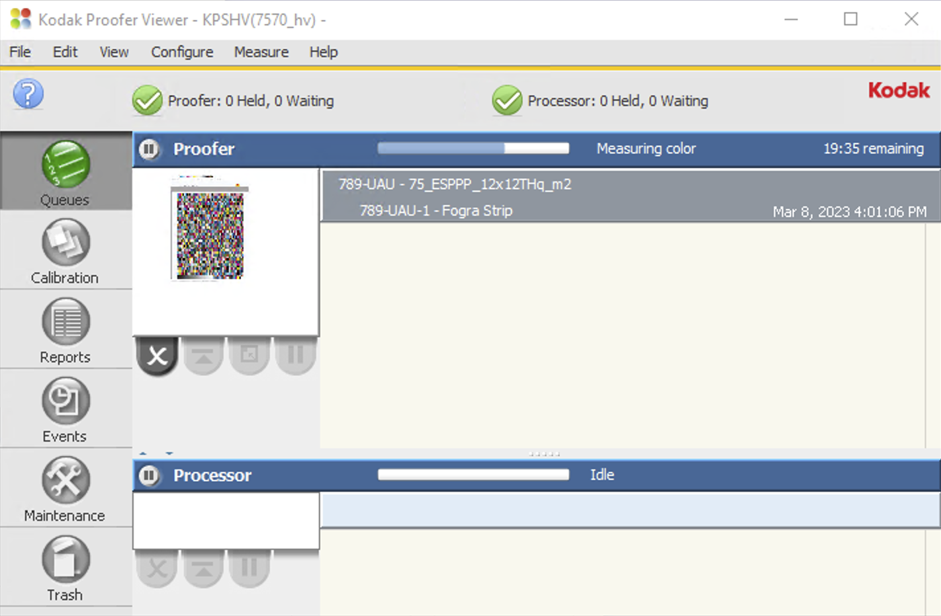
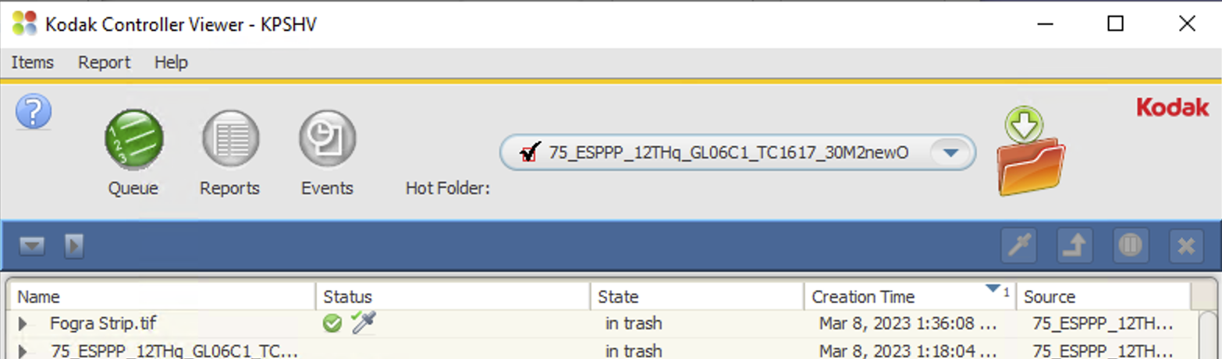
Step 4: Dry then Measure the Profile Verification Color Bar
This can be done automatically using your inline spectrophotometer, or manually with an offline device.

Slide 26
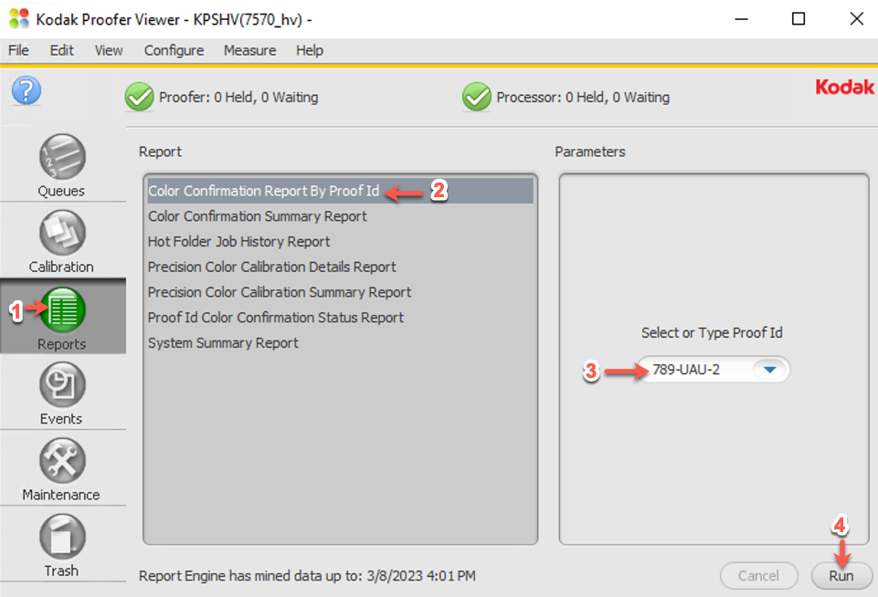
Step 5: Create a CPCC Color Report for Profile Verification
In the KPS Proofer Viewer:
Click the “Reports” Tab
Select “Color Confirmation Report By Proof Id,”
Select the Proof ID for your Profile Verification Chart (should be the first one in the list),
Click “Run”.

Slide 27
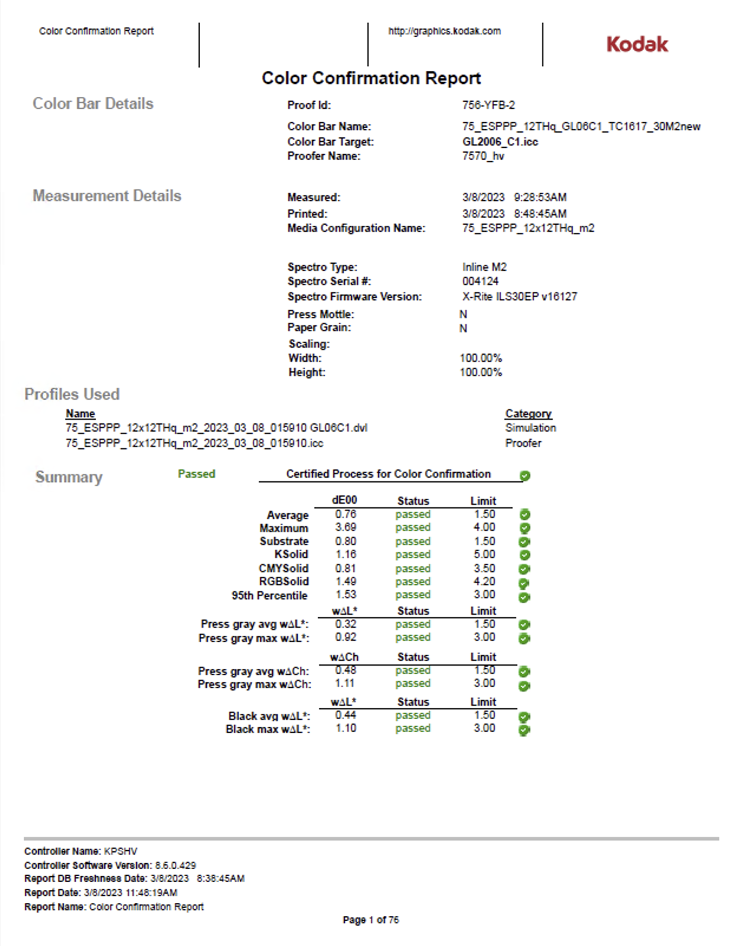
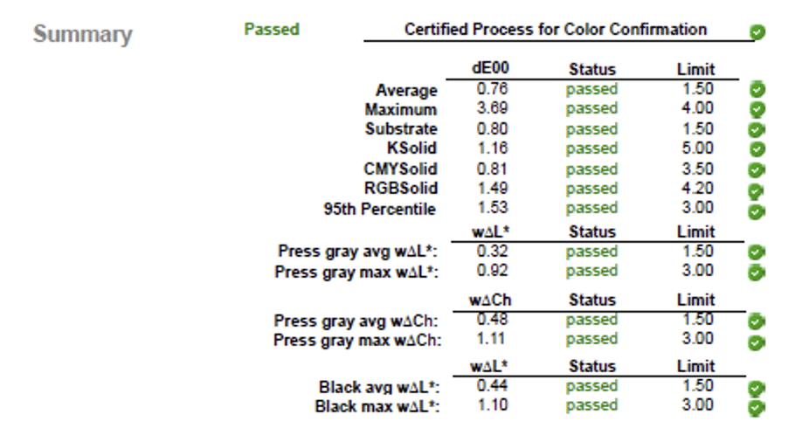
Step 5: The CPCC Color Report for Profile Verification
The Report can be opened using various free tools including the Microsoft Edge application or Acrobat Reader.
The CPCC/Profile Verification report contains all the necessary parameters to send to GraCoL for color certification. Note that all parameters must pass in order to be certified.

Slide 28
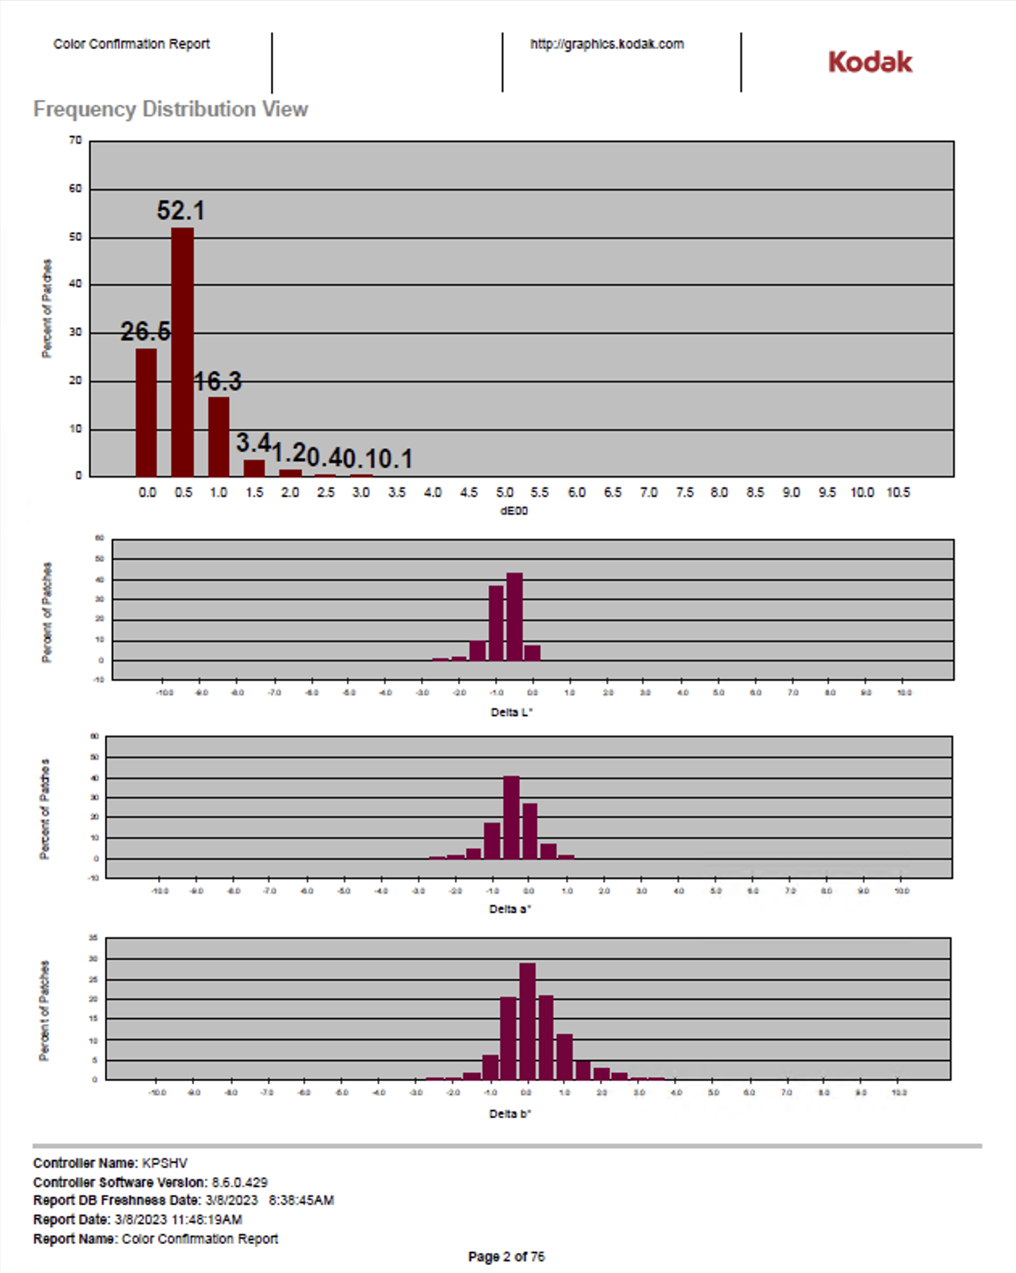
Step 5: Create a CPCC Color Report for Profile Verification
Some useful data
The histograms are a useful tool to analyze the performance of your Media Config + profile performance.
The histogram on the top is showing that 26.6% of the colors are between 0 and 0.5 dE00, 52.1% of the colors are between 0.5 and 1.0 dE00, etc.
If you add them up….
  (26.6 + 52.1 + 16.3) = 95% of the colors are less than 1.0 dE00.

Slide 29

Troubleshooting
What to do if your custom color setup does not achieve the results you are looking for?

Slide 30
Here are the most common areas of trouble…
Media Quality
  Color of Media
    White point – should be close to that of the target white point.
    White Point not compatible with Media type. – check paper manuf. For compatibility. Best results with Epson Media on Epson Proofer.
    Proper measurement Condition – some color targets/media requires a specific measurement condition.
  Color Gamut not compatible with Media type. – check paper manuf. For compatibility. Best results with Epson Media on Epson Proofer.
Improper Media Configuration Settings
  TIL – too low or too high (most Semi-Matte media types are never higher than 1.0, for P75/P95 never higher than 0.8)
  Paper Feed – try choosing again with the new chart in KPS v8.5 or higher; and re-create the custom Media Config + profiles.
  For Best color results create a new custom Media Configuration. Kodak Factory Media Configs are not for color-critical work.
Spectrophotometer issues
  Difficulty with hand measuring devices
  Inline devices
    Use White backing strip supplied by the manufacturer.
    Ensure Matching white tile installed (White tile serial number must match the Spectro serial number).
Printer performance
  If your Inkjet Printer has been unused for a long period of time it should be “warmed-up” before creating your
    custom Media Config + Profiles (see “How Do I Prepare” slide).
  Partially clogged printer head(s) – may cause inconsistencies, leading to higher color differences.
  Recently changed ink cartridge(s) might cause the color to shift during the setup process.
  Newly installed printers – must completely change out all of the installer ink kit (1 or 2 full days of printing).

Slide 31
Optimizing DeviceLink Profiles in KPS
* Requires a KPS Commercial or Packaging license
Under normal conditions, an optimized DVL is not necessary. The best performance will be achieved by creating a good profile from the start. It is recommended to follow the troubleshooting instructions first, to create the best ICC DVL.

Slide 32
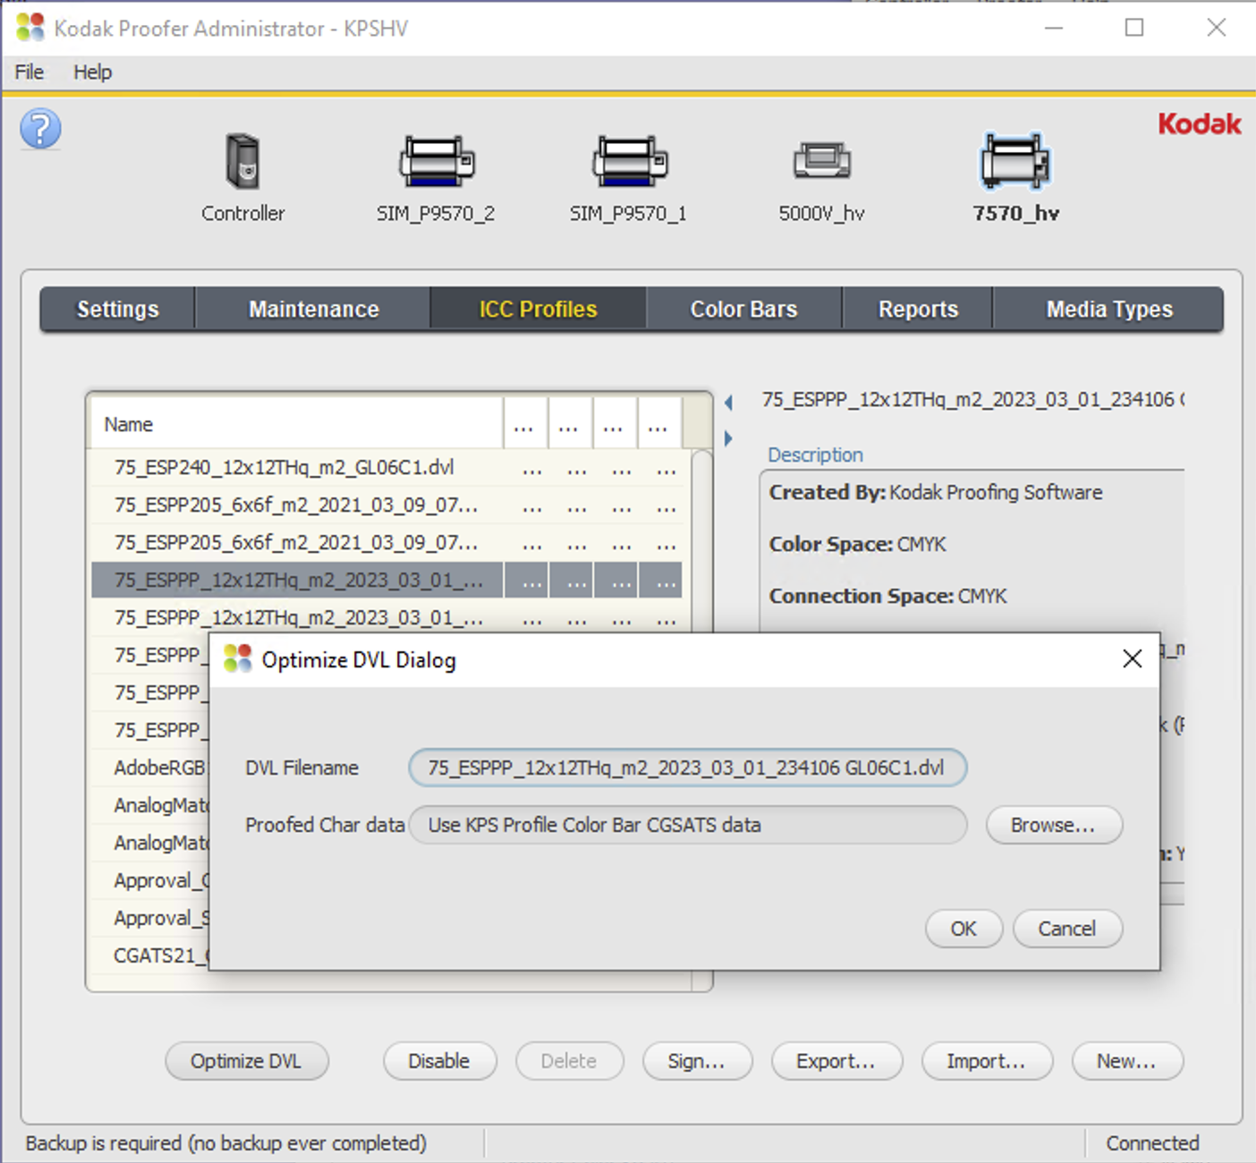
Optimizing a Kodak ICC DVL.
You can use your Profile Verification measurement data to optimize a Kodak ICC DVL (this algorithm only works with ICC DVLs created by Kodak Software).
If you measured your Profile Verification chart using Kodak ColorFlow Software you can export your measurement data and select it, using the “Browse…” button.
In the example shown the KPS measurement data is automatically selected. KPS can Optimize your DVL with one click of the “OK” button. The optimized DVL will appear in the profiles list, with a new date on the end of the name.
You will need to repeat the Profile Verification procedure to verify the color performance of the new Optimized DVL.

Slide 33
Creating DeviceLink Profiles in KPS
* Requires a KPS Commercial or Packaging license
ICC DeviceLink profiles are a powerful application of the mathematics of device profiles. They effectively combine two device profiles to create a one-way link with a single rendering intent, and can be used to align color on different output devices.
A DeviceLink uses a color lookup table to transform CMYK input values in the source color space to CMYK output values in the destination color space.

Slide 34
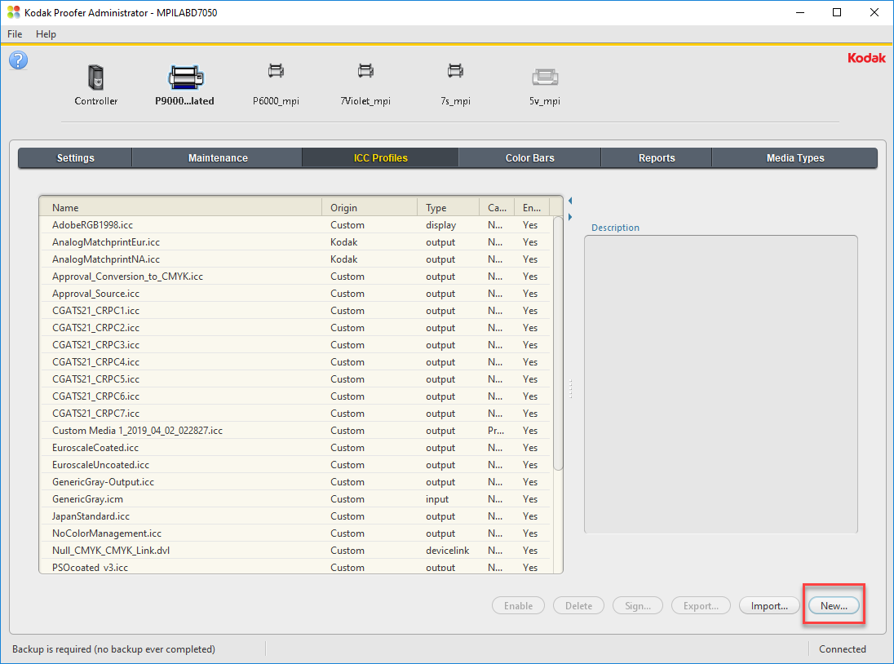
Step 1: Create new DeviceLink Profile
Launch the Kodak Proofer Administrator:
Select the Proofer
Select the ICC Profiles Tab
Click on New

Slide 35
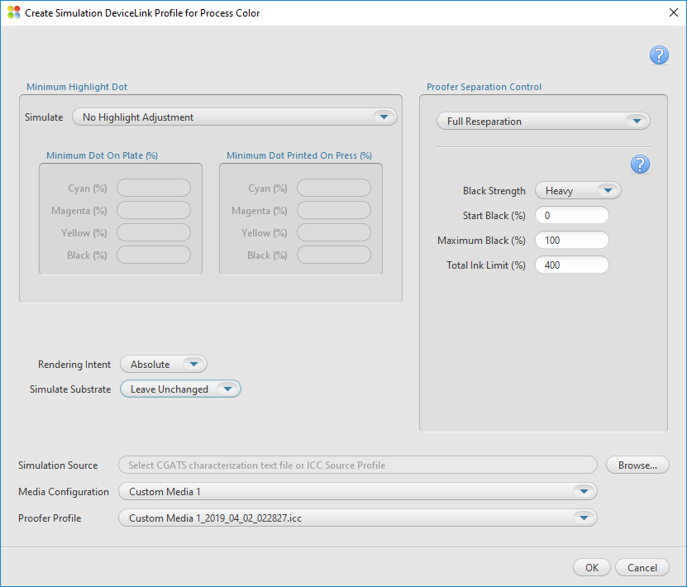
Step 1: Create Simulation DeviceLink Profile Dialogue Box

Slide 36
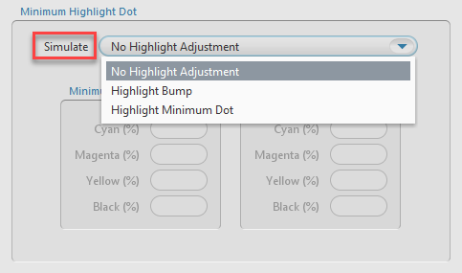
Step 1: Simulate
Simulate option | Press characterization data
No Highlight Bump | Select characterization data that reflects a press run without flexographic highlight dot adjustments.
Highlight Bump | Select characterization data that reflects a flexographic press run with plates imaged for a highlight bump. For the best results, the characterization data should reflect the number(s) that you type in the Minimum Dot on Plate (%) area in the Cyan, Magenta, Yellow, and Black boxes. For example, type 8.0 in the Minimum Dot on Plate (%) boxes when you are using the sample characterization file named IT874_Highlight_Bump_8.cgt.
Highlight Minimum Dot | Select characterization data that reflects a flexographic press run with plates imaged for a highlight minimum dot. For the best results, the characterization data should reflect the number(s) that you type in the Minimum Dot on Plate (%) area in the Cyan, Magenta, Yellow, and Black boxes.

Slide 37
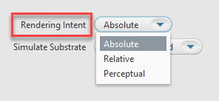
Step 1: Rendering Intent
Defines how to transform the file. Rendering intents are available only when ICC Handling is set to ICC Profiles. Select one of the following options:
Relative—transforms colors without simulating a paper tint. The Relative rendering intent clips out-of-gamut colors.
Absolute—transforms colors and simulates a paper tint. The Absolute rendering intent compresses out-of-gamut colors and maps them to the edge of the gamut. This setting is recommended for all Certified Process for Color Confirmation work.
Perceptual—transforms colors without simulating a paper tint. The Perceptual rendering intent compresses all colors to map them to the smaller color space. Use Perceptual for imposition media.

Slide 38
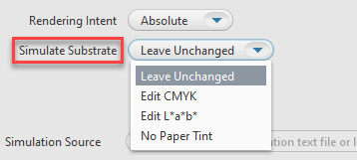
Step 1: Simulate Substrate
When the Rendering Intent list displays Absolute, you can choose to define a substrate in the inkjet proofer color space (not the press color space). The software will override the substrate definition in the characterization data with the new substrate definition.
Leave Unchanged: turns off the override, and uses the substrate definition in the characterization data.
Edit CMYK: lets you define the substrate in CMYK tint percentages. Type a percentage from 0 to 100. Changes will be spread to colors near the white point.
Edit L*a*b*: lets you define the substrate in L*a*b* color space. In the L* box, type a number from 0 to 100. In the a* box and the b* box, type a number from -128 to 127. Changes will be spread to colors near the white.
No Paper Tint: Sets the White Point CMYK value to zero; while leaving all other colors around the white point unaltered.

Slide 39
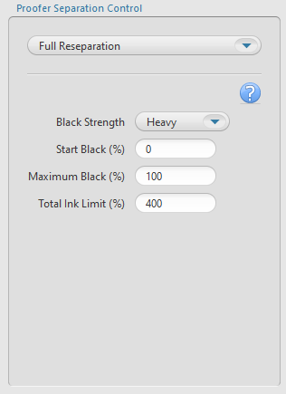
Step 1: Proofer Separation Control
Black Strength: To specify the relative quantity of black vs cyan, magenta, and yellow used to generate the neutral gray component of colors. As you increase the strength, colors can contain more black.
Start Black: Specify the start point on the neutral axis for black ink. For example, if you set the start point value to 20%, tones less than 20% will print with CMY inks only
Max Black: Specify the maximum allowable percentage of black ink used in the black separation
Total Ink Limit: Specify the maximum sum of tint values of all the inks

Slide 40
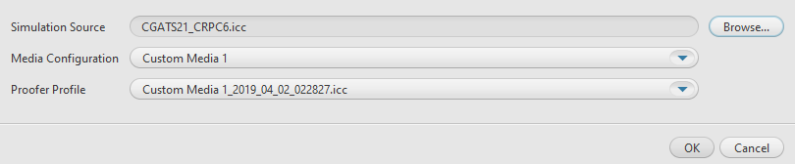
Step 1: Simulation Source, Media Configuration and Proofer Profile
Simulation Source: Select an ICC Source Profile or a CGATS5 File of spectrophotometer measurements of the IT8.7/4 chart printed on the press or proofer that you want to simulate.
Note: The supplied CGATS files are located in the Proofer Client > Docs folder (D:\Program Files\Kodak\Proofer Client 10.x.x.x\Docs)
Media Configuration: Select a media configuration to use with the DeviceLink
Proofer Profile: Select proofer profile on which to base the DeviceLink

Slide 41
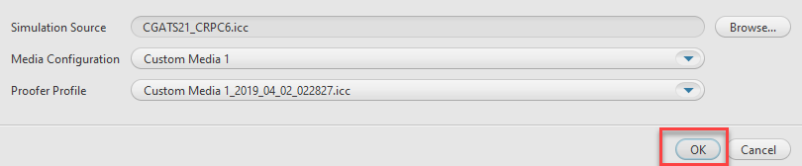
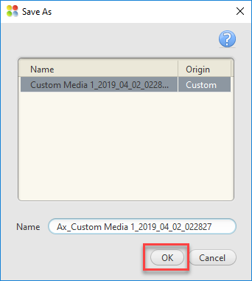
Click OK to Save the Settings
Give a name to the DeviceLink Profile and Click OK to Create the DeviceLink Profile

Slide 42
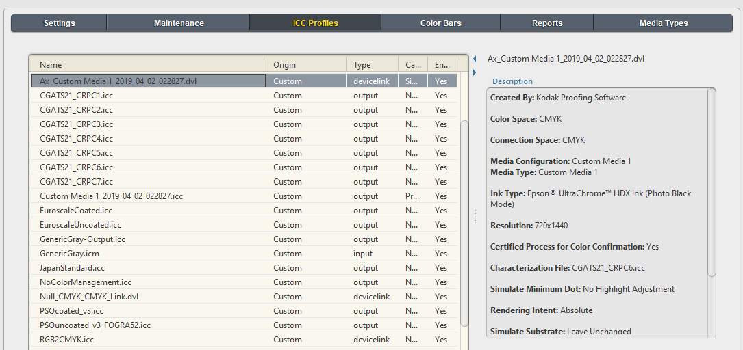
The DeviceLink Profile will appear in the ICC Profiles List and it will be signed for
Certified Process for Color Confirmation

