Slide 1
Introduction
Kodak ColorFlow Software Training
Notes:
Kodak’s revolutionary ColorFlow Software Solution provides a unique opportunity to integrate a large set of existing products and tools into one platform, deliver enhanced functionality and simplify setup of color reproduction for you

Slide 2


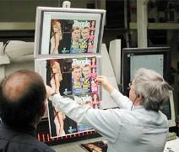
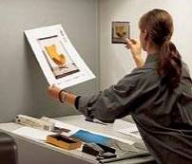
Color – It’s what we do
You are in the business of managing printed color.
Today, there are many tools, procedures, and processes for setting up color within the production environment.
Notes:
You are in the business of selling printed color.
Today, there are many color tools, procedures and processes for setting up color within a production environment. But these tools do not lead you through a complete setup solution that can be tracked and reported. They often live on their own – being managed and implemented separately leading to much confusion and a high risk for human error to occur. Inconsistent color throughout the production process remains one of the main cause of reworks in the graphic communications industry, and that impacts Print Service Provider’s revenue as well as their ability to deliver consistent quality to their customers.

Slide 3
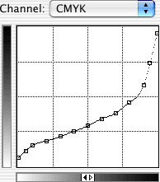


The Color Challenge
Curves
DeviceLink
ICC Profiles
Many color elements are needed to make “that” look like “this”.
Spot recipes
Notes:
The challenge today is that many color control elements such as ICC profiles, curves ,and spot color recipes, are needed to make “that” look like “this”

Slide 4

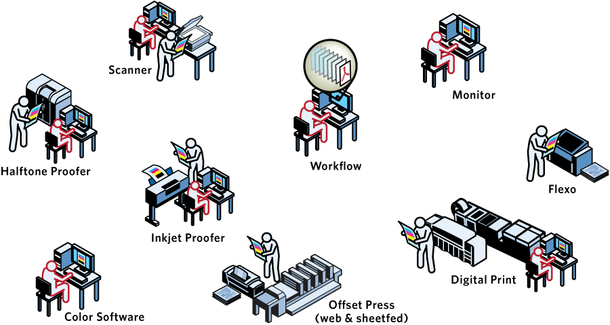


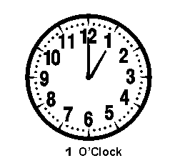
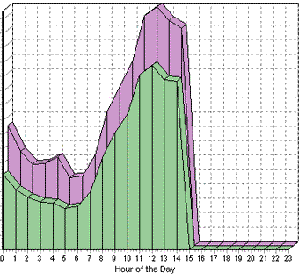
Independent Color Systems
Color changes when normal production variables occur.
Resources and time are required.
There are many color elements across devices.
Notes:
These devices are generally independent color systems existing with little or no workflow and their own color management solution at each front end
[click]
However, as a color change may occur when normal production variables are altered in some way, such as change of ink or paper, the color output of each device moves accordingly and requires recalibration or color management to realign.
[click]
This means that a color expert is required to manage and update the profiles and curves for each independent color system when changes occur in order to maintain consistent color production
[click]
In order to achieve this calibration and color management on each system, many color elements are used resulting in the need to manage these elements across the production environment

Slide 5
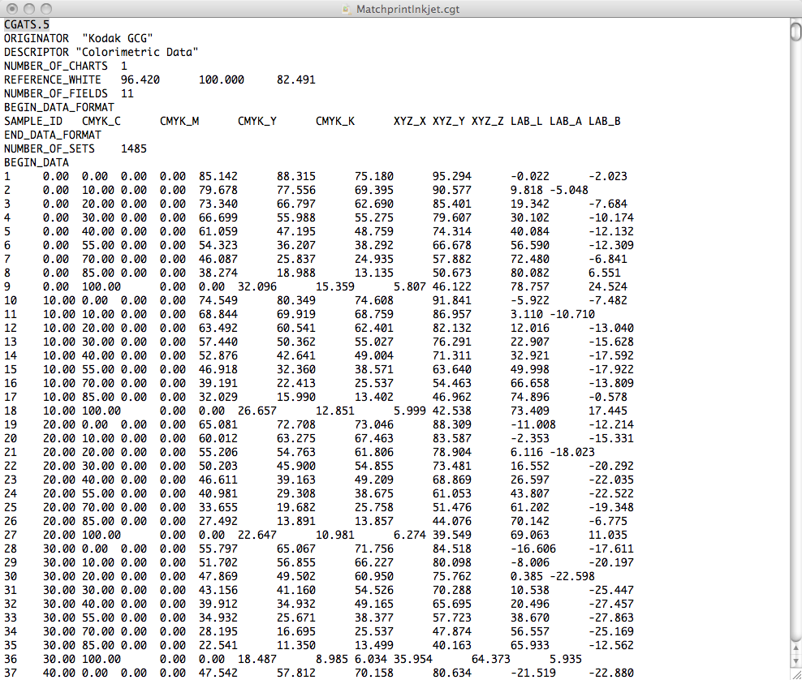
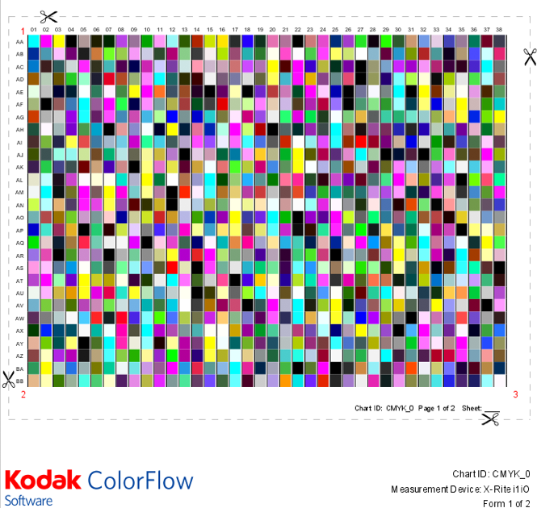
Color by the numbers

Slide 6
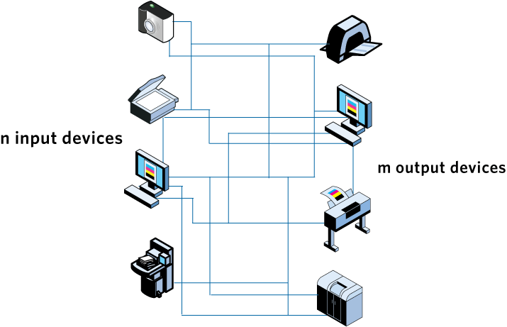
Complex Conversions
Many input-to-output device conversions
Notes:
In a typical color production environment, the color setup procedure involves many complex conversions between many devices in order to try and achieve a desired result

Slide 7




Why Using ColorFlow?
  Integration with Prinergy Workflow: simplifies production and increases automation
  One application for tonal calibration and color relationship management
  Automatic updates when color adjustments are made
  Do more: evolve from simple tonal calibration to grey-balance calibration (i.e. G7)
  Edit by the numbers using lab dot gain or optional Visual color editing for accurate on-screen color when editing profiles and curves
  Comprehensive print condition reporting tools
  Fully endorses ISO printing system standardization recommendations, and supports international data exchange formats and job control specifications
Notes:
In order to manage the ecology of color in a production environment, ColorFlow Software uses a number of leading-edge color technologies to provide key features, such as:
ColorFlow Software’s integration with Prinergy simplifies and clarifies the choices that need to be made in the workflow software, and focuses the setup of color in just one place. Fewer places where complex decisions need to be made mean fewer points of failure for a more bullet-proof color workflow.
The complex web of color relationships in a modern press shop between color standards, presses, and proofers can be quite difficult for most people to keep track of manually. If any node in the web is disturbed, for example if the press changes to a different paper or ink type, then the entire web would normally require a great deal of manual attention to re-balance. ColorFlow software automatically updates the entire web of color relationships if one of the elements changes, helping keep the color of all the devices in the shop aligned with one another.
Kodak brings over a decade of experience with Superior Color engine technology and smart CMM (color management module) technology. Smart CMM provides the full benefit of ICC color management, but keeps blacks black, and colors pure.
Using tonal transfer curves has been a traditional way for printers to calibrate and tune their presses. In addition to simply matching TVI (tone value increase) values, it is sometimes necessary to perform a further adjustment in order to achieve a desired color result, for example to achieve a good gray balance match on press to some other print condition. Kodak’s gray balance curve technology uses unique algorithms to calculate tonal transfer curves for optimal effect, giving a well balanced color match across the entire spectrum of colors, taking into account not only the color of the single inks but also the color of overprints. Actual color on press is dependent on a combination of the amount of ink from 2 or more colorants, which need to be carefully balanced against one another. Editing tonal transfer curves can be a hit-and-miss procedure of adjusting the colorants one at a time, involving guesswork regarding the final effect. The ability to edit Gray balance curves allows users to adjust cyan, magenta, and yellow curves in line with each other in order to achieve a particular color effect on the gray balance of the overall print.
The same technology enables Ink Optimizing, which allows users to reduce the ink usage and increase the print quality of their CMYK print jobs through greater print stability.

Slide 8
Editions of ColorFlow Software
ColorFlow software, Workflow edition
  Generate and edit curves
  Import ICC device profiles and ICC DeviceLinks
  Free with Prinergy Workflow
ColorFlow software, Pro Workflow edition
  Chargeable upgrade for Prinergy Workflow
  All the functionalities of the Workflow edition
  Generate and edit ICC device profiles and ICC DeviceLinks
  Includes ColorMatch on Output for Prinergy
  An optional licensed Ink Optimizing Solution feature

Slide 9
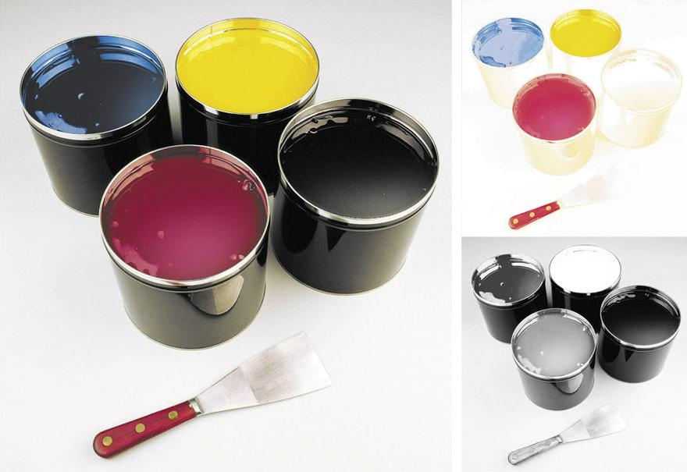
Ink Optimizing Solution
A licensed feature to generate DeviceLinks
Use Gray Component Replacement to reseparate images and replace chromatic colors with black
Improves print stability on press and reduces ink consumption

Slide 10
Overview
Kodak ColorFlow Software Training
Notes:
Kodak’s revolutionary ColorFlow Software Solution provides a unique opportunity to integrate a large set of existing products and tools into one platform, deliver enhanced functionality and simplify setup of color reproduction for you

Slide 11
Devices and Device Types
A Device in ColorFlow Software is any physical device in your environment that captures or produces an image. Devices are identified by:
A name that you choose (such as Speedmaster 102 or Epson)
A type (for example, Sheetfed or Inkjet). The type allows ColorFlow Software to associate it with similar devices.
A Device Type differentiates devices into categories to allow for easier device management:
Curved devices include offset press and halftone proofers.
Non-curved devices include digital presses and
inkjet proofers.

Slide 12
Device Condition
A Device Condition is an important concept in ColorFlow Software. It is a combination of:
  A device
  The operating conditions in which the device captures or produces an image
A Device Condition has a measurable color response.
A device can have multiple Device Conditions, depending on screening, substrate, or other variables that affect the color response.
Devices of the same device type can share the same Device Condition.

Slide 13
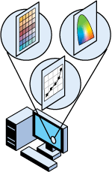

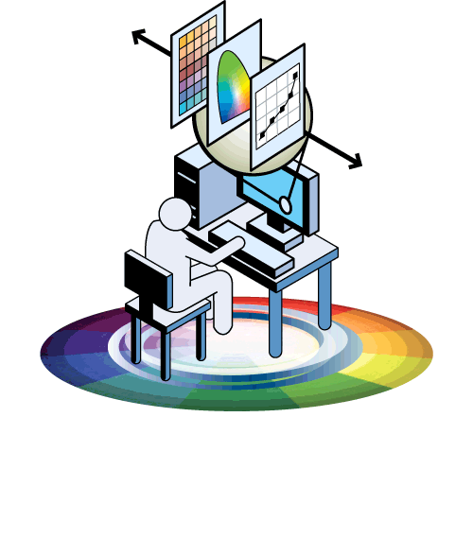
Color Control Objects
Color is intrinsically controlled by two objects in the graphics workflow: Curves and ICC Profiles
Curves can be separated from Profile to make tonal adjustments
Profiles were implemented to achieve a higher degree of color fidelity, beyond the scope of a set of 1D curves
Notes:
Color Relationship Management means that we unify all the color elements together managing the relationship between them and the device print conditions
The software enables gray balance color control and editing utilizing superior color technology to provide better color results. Gray balance curves using unique algorithms for a balanced color match – better color faster
Tight integration with the workflow and between devices enables automatic updates when production variables occur or a print condition is redefined.

Slide 14
Curves
Applying calibration curves is a standard method of controlling color on curve-controlled devices:
Plate calibration curves: create a plate calibration curve to linearize a plate
Print calibration curves: create print calibration curve to make the response of a curve output device condition match the response of a target device condition
Print transfer curves: create print transfer curve to control the response without measuring a response and defining a target

Slide 15
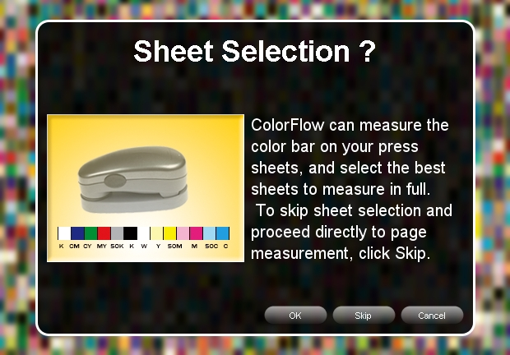
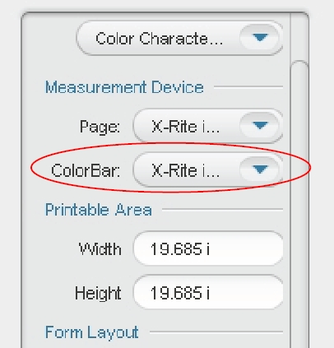
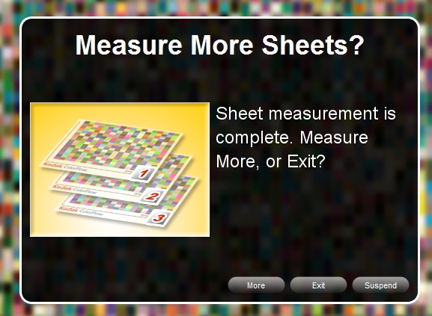
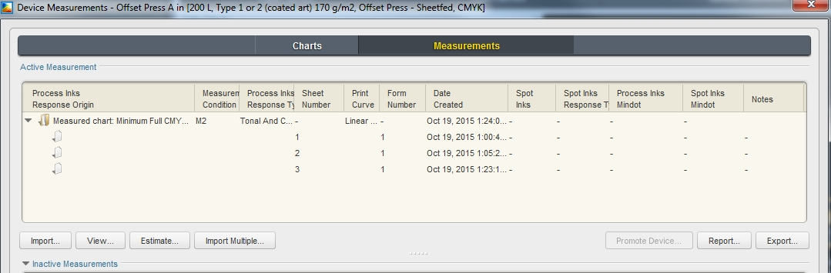
Measurements
Can select the best sheets to measure in full and measure multiple sheets to capture the most accurate data

Slide 16
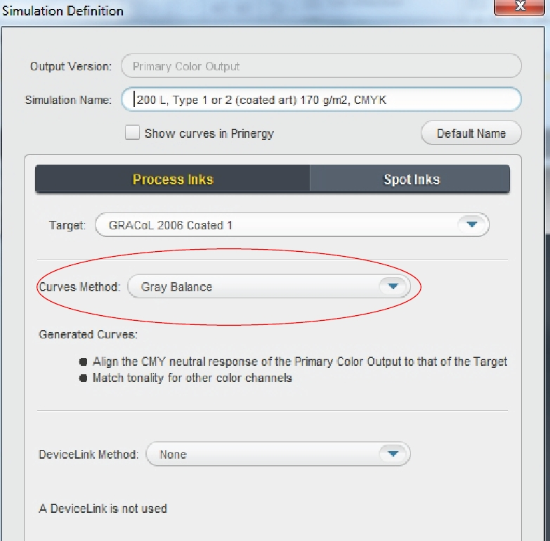
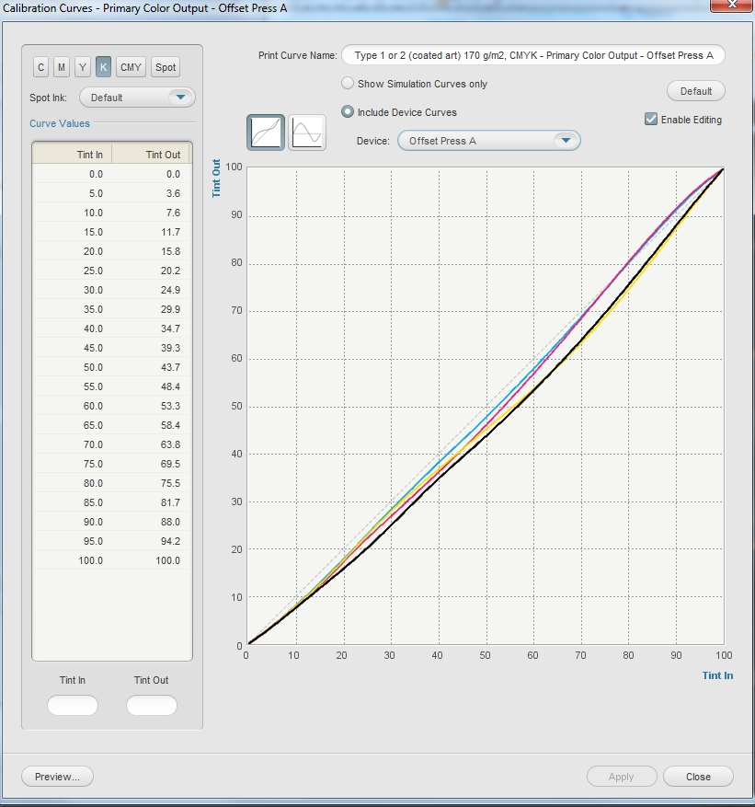
Gray Balance Curves
Gray balance curves using unique algorithms for a balanced color match: better color, faster

Slide 17
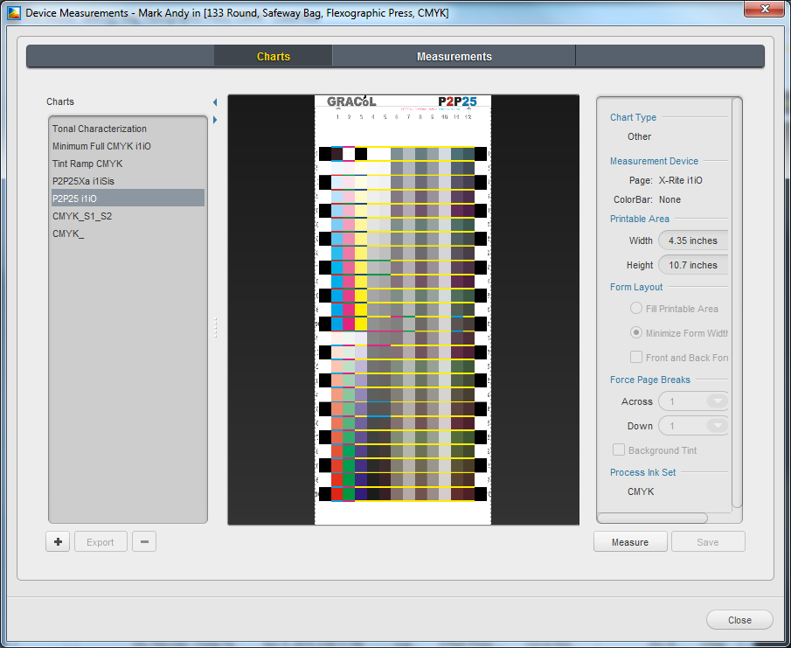
G7 Gray Balance Calibration
Native support for P2P25 chart (G7 methodology)

Slide 18
Reports
ColorFlow Software generates reports that summarize color and assist in troubleshooting.
ColorFlow produces the following types of reports:
Print Characterization Reports present information on a device based on measurement data
Print Comparison Reports illustrate the differences between a device and a selected target
Verification Reports illustrate the differences between the response of a device and the response of the target
Notes:
So now hopefully you have a better overview of the software features and capabilities lets look at some of the key benefits to your business
One of the key benefits of ColorFlow Software is reducing the setup costs
Usually, users need to run 3 or more press runs in order to fingerprint a press to the degree that they can set up press curves and a source profile for the press. ColorFlow software intelligently uses all of the color data from a press run in order to calculate the press curves and the press profile at the same time, thereby also ensuring that the curve and profile are also related to one another properly.
Comprehensive reports can reduce setup costs even further by summarizing the color and assisting in troubleshooting – here you can see some examples of the type of report information generated

Slide 19
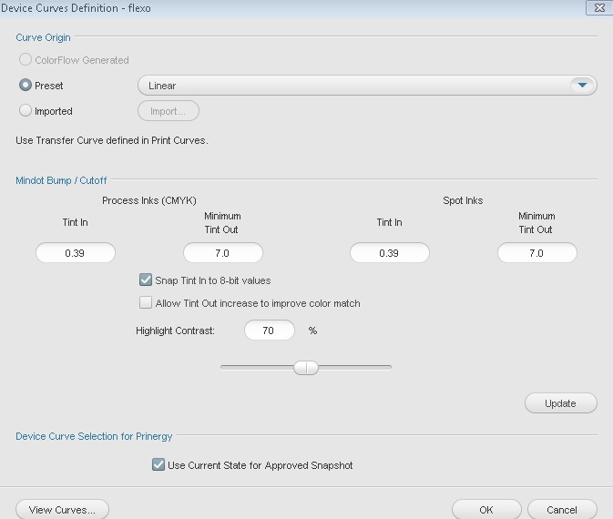
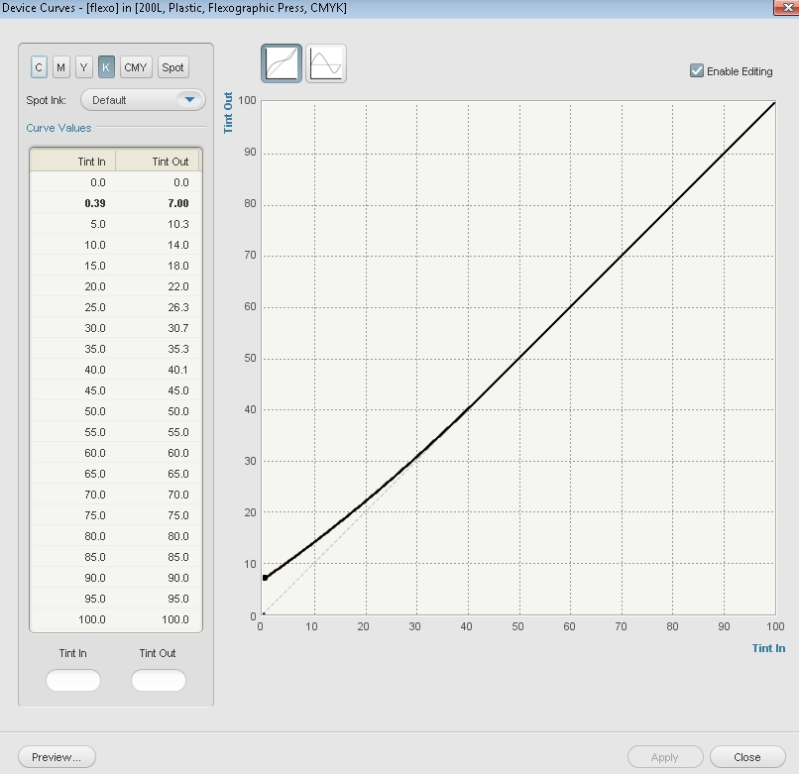
Flexographic Support
Flexographic press device type
Mindot Bump / Cutoff curve support
Notes:
ColorFlow 2.0 annd later includes end-to-end support for flexographic printing. This means not only controlling the response of flexographic press, but also profile generation for your proofing systems so you can preview the effects of your bump or cutoff curves, and curve edits, before running production jobs on press.
Key requirements:
compensate for scum dots by bump or cut off curves in the highlights
Narrow-web with Flexcel NX (no bump curves), but Wide web Flexcel NX; all LAMS plate applications (bump curves required)
A complete Dotshop with ColorFlow solution
Proofer simulation of bump and cutoff curves
Note: Narrow web 6 to 24 inches
Wide web 24 to 90 inches, 120 inches for corrugated presses

Slide 20
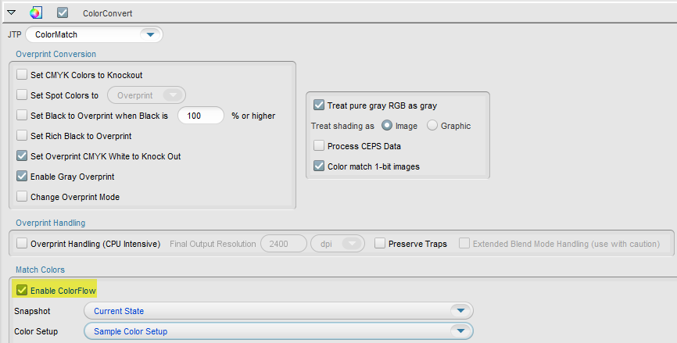
Using Prinergy with ColorFlow
Can simply turn ColorFlow on or off in Process Templates

Slide 21
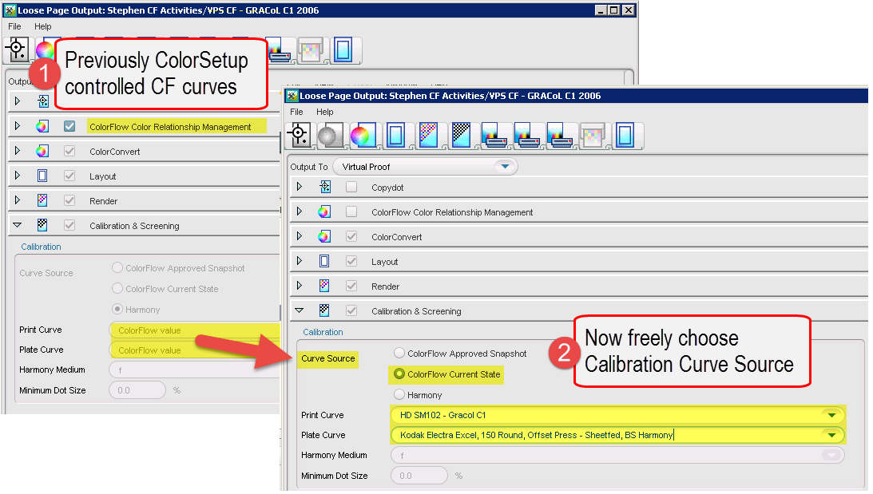
Using Prinergy with ColorFlow (Continued)
Tonal Calibration can be separated from Color Relationship Management

Slide 22
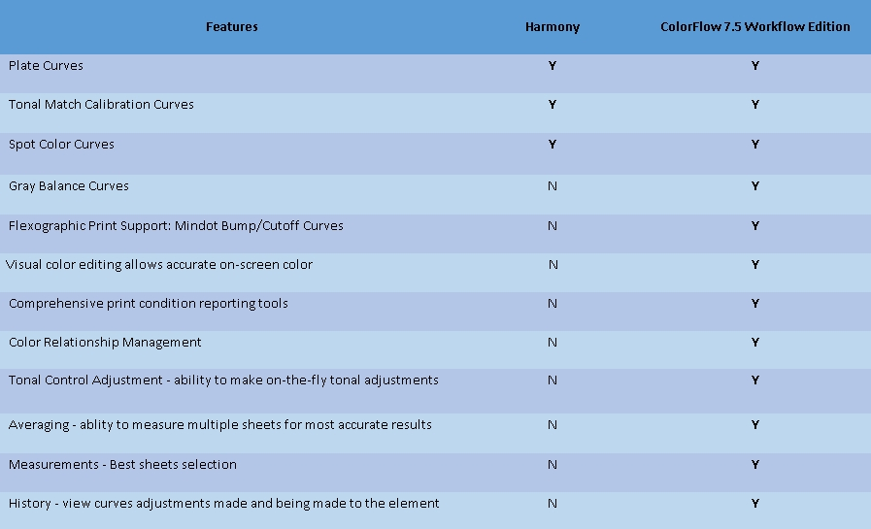
ColorFlow Feature Comparison with Harmony

Slide 23
Demo
Kodak ColorFlow Software Training
Notes:
Make sure that you briefly cover the following:
color setup (add, delete, duplicate), Help menu (licensing, Online Help), add device (to the device window), PCO, icon states, device condition, charts, simulation target, SCO, conversion link, snapshot, reports, color control elements adjustment, history window, plate setup, sticky note

Slide 24
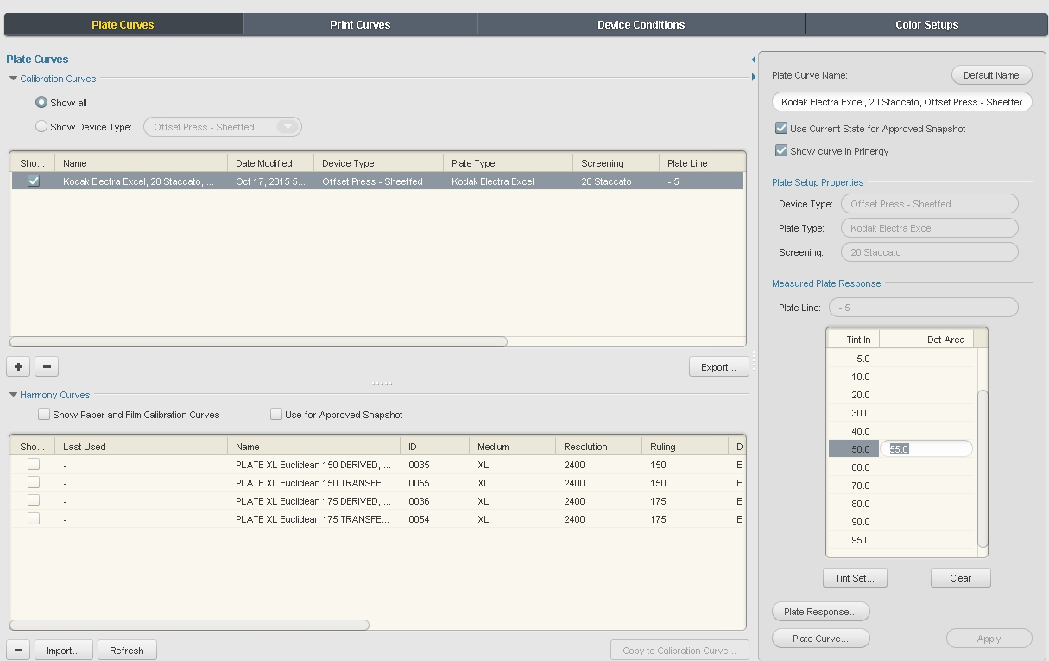
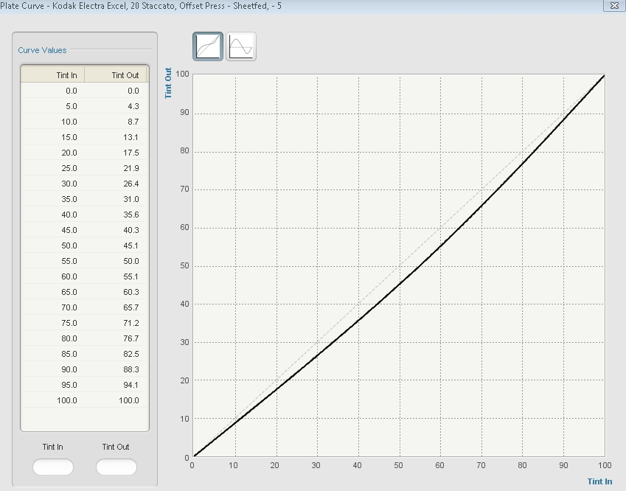
Create a Plate Calibration Curve
Enter the measured Dot Area values for each Tint In value
View curve graphs in Tint out or Tint change view

Slide 25
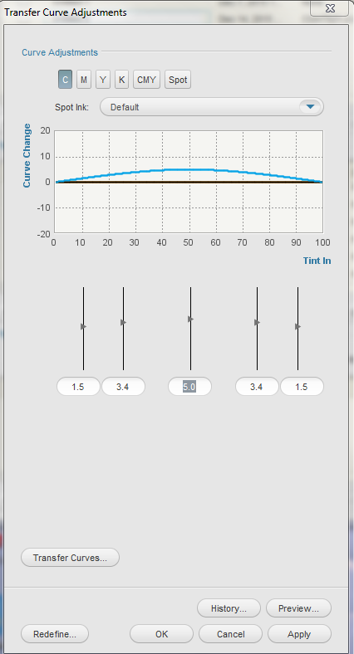
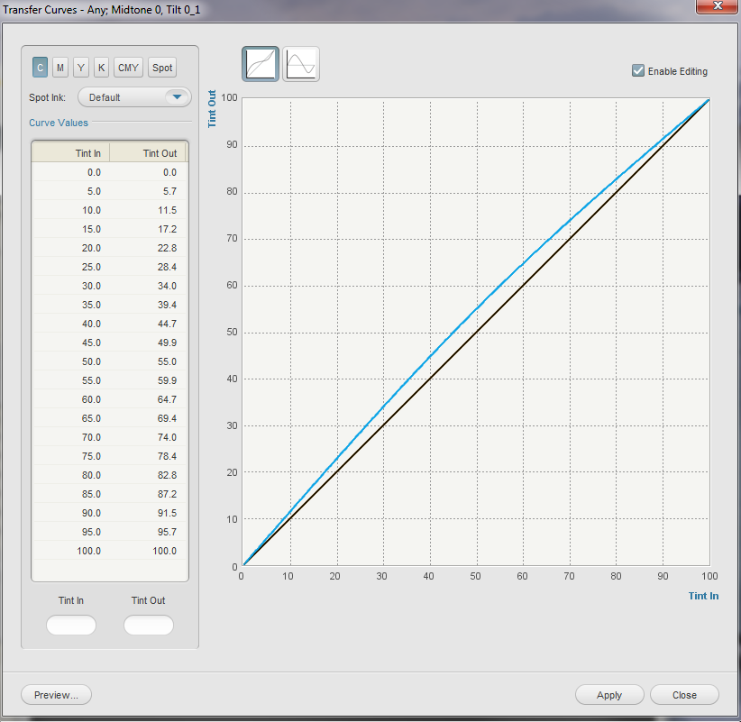
Create a Print Transfer Curve
Create a linear transfer curve as the start point
Edit the transfer curve to get the desired output

Slide 26
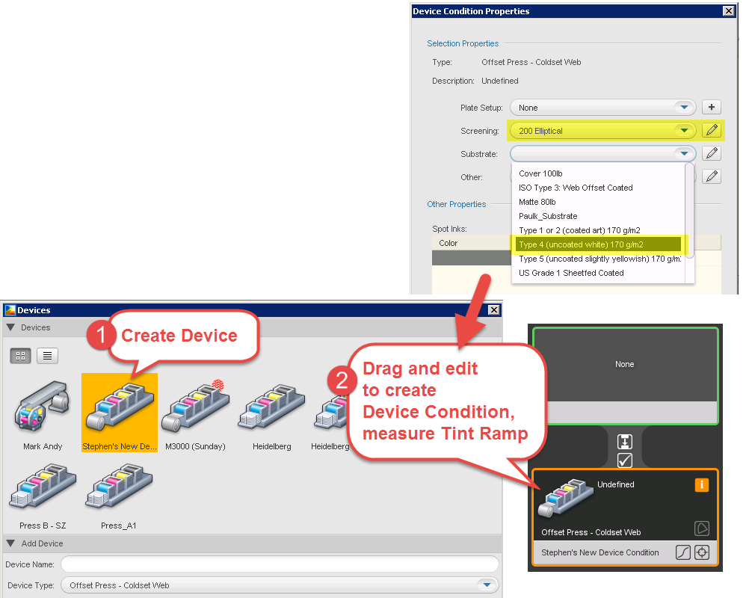
Create a Print Calibration Curve
Create a Device Condition
based on a measured response (printed Tint Ramp)
Define Target response
based on an industry standard
and choose Curve Method
  Tonal Match or
  Grey Balance

Slide 27
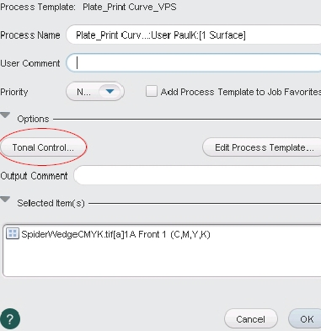
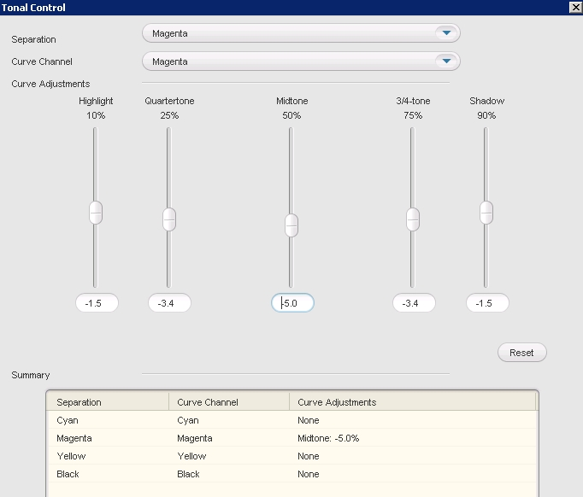
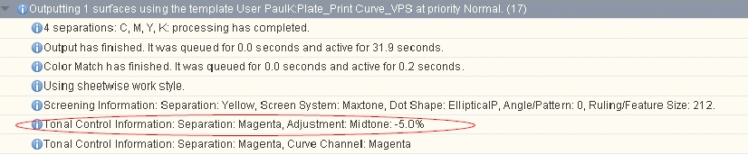
Make on-the-fly Tonal Adjustments
Make an on-the-fly Tonal Match tonal adjustments in Prinergy, and track edit history made in the Tonal Control

Slide 28
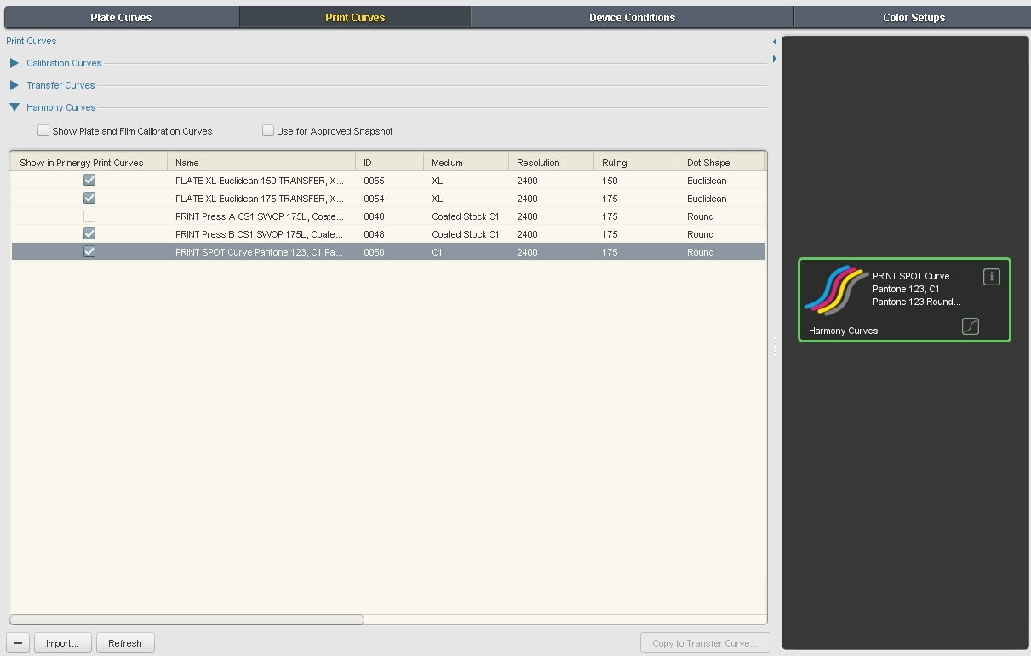
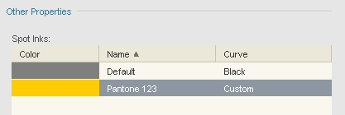
Add a Spot Ink to the Print Curve
Add a custom spot ink that uses a unique curve to control its tonality

Slide 29
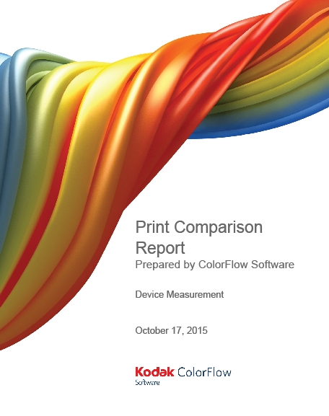
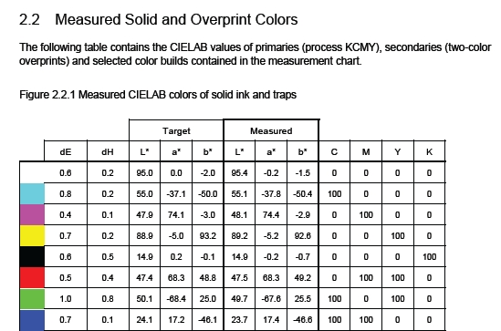
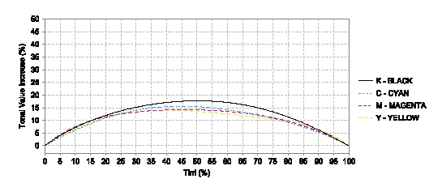
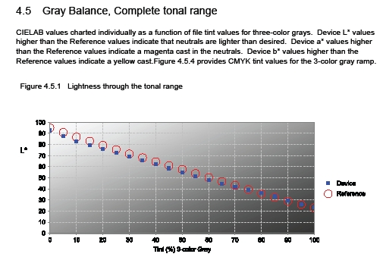
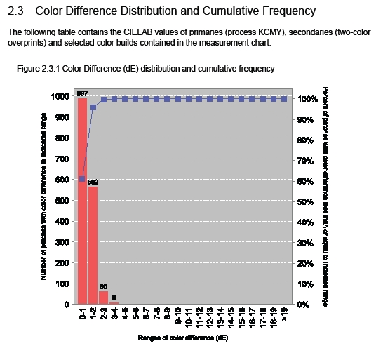
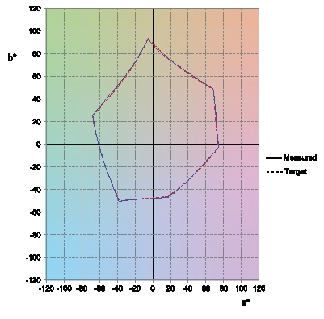
Create ColorFlow Reports
Reports are generated from the Measurements tab in PDF format

Slide 30
Curve Editing
Kodak ColorFlow Software Training
Notes:
Make sure that you briefly cover the following:
color setup (add, delete, duplicate), Help menu (licensing, Online Help), add device (to the device window), PCO, icon states, device condition, charts, simulation target, SCO, conversion link, snapshot, reports, color control elements adjustment, history window, plate setup, sticky note

Slide 31
Tonal Adjustment Tool
Key points:
Simple curve tonal adjustments – works well for small “tweaks”
Edits expressed in % change difference values
Must use sliders or data entry
Edits must be between -20% and +20% difference values
Make midtone adjustments first, then other tone scale edits
Individual curve and 3-color gray balance adjustment

Slide 32


Tonal Adjustment Tool – Example
Print Curve – adjust offset press back to characterization state.
Prior to Edit
Post Edit
3-color gray bar at
time of Characterization
3-color gray bar
(3 months later)
3-color gray bar after device curve edit
Original 3-color gray balance
Current Color Assessment: Press is too cyan and darker
Goal is to adjust device curves “Before” view to bring 3-color gray back to original state.

Slide 33
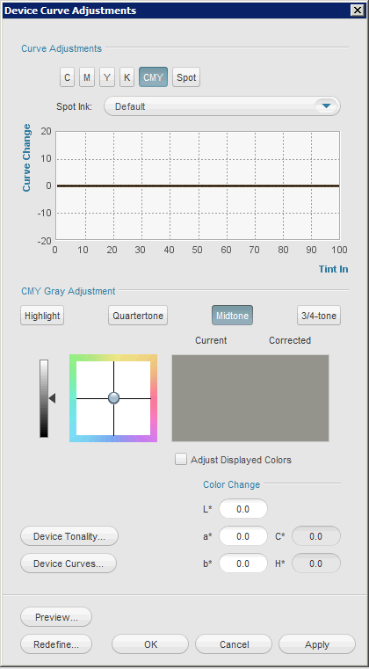
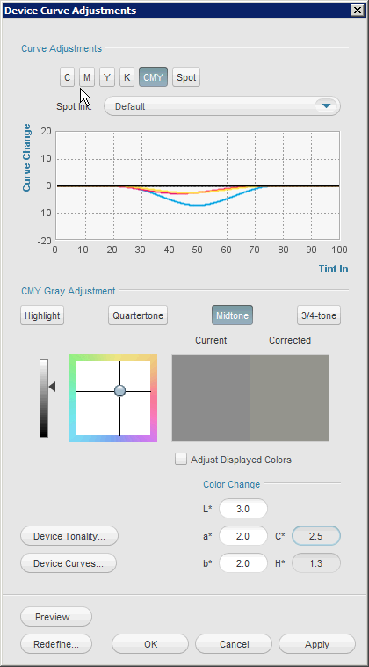
Tonal Adjustment Tool – 3-color gray
Adjust “Before” view to match current color of press.
Before: 0% CMY change
After: a*+2, b*+2, L*+3 @ midtone

Slide 34
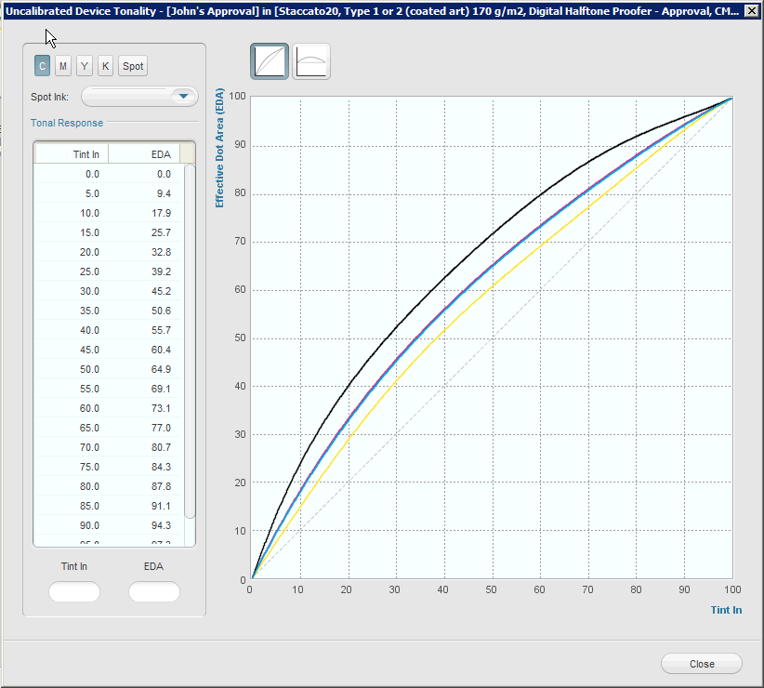
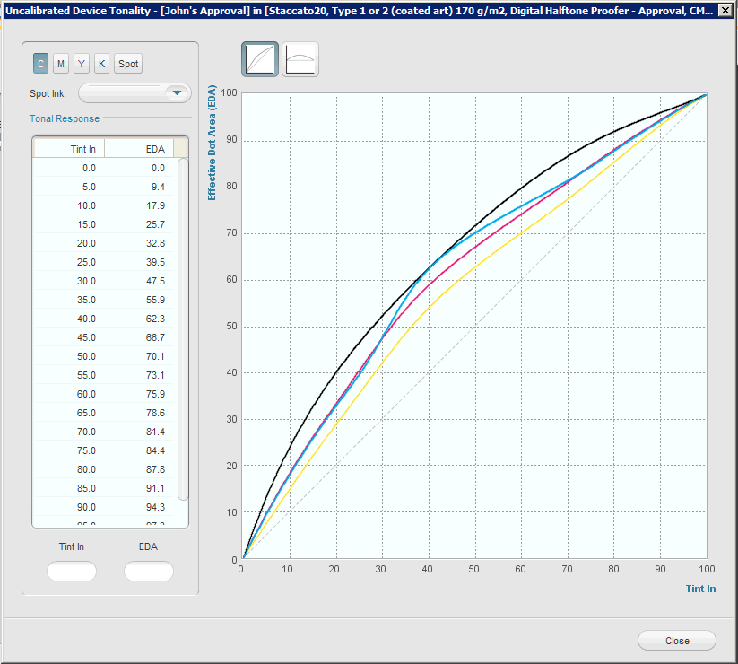
View Response 3-color gray (Uncalibrated Device Tonality)
Before: 0% CMY change
After: a*+2, b*+2, L*+3 @ midtone

Slide 35
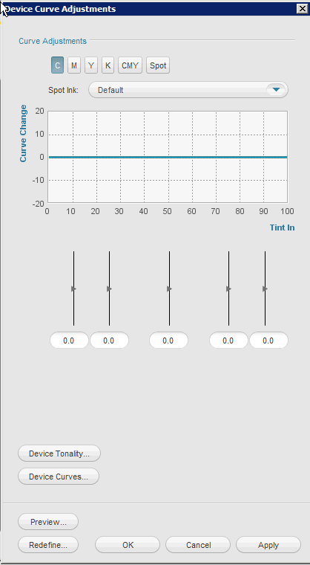
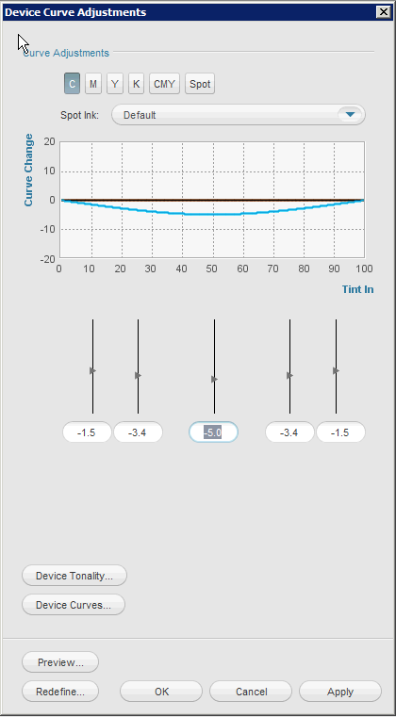
Tonal Adjustment Tool – single channel
Before: 0% Cyan change
After: -5% Cyan @ midtone

Slide 36

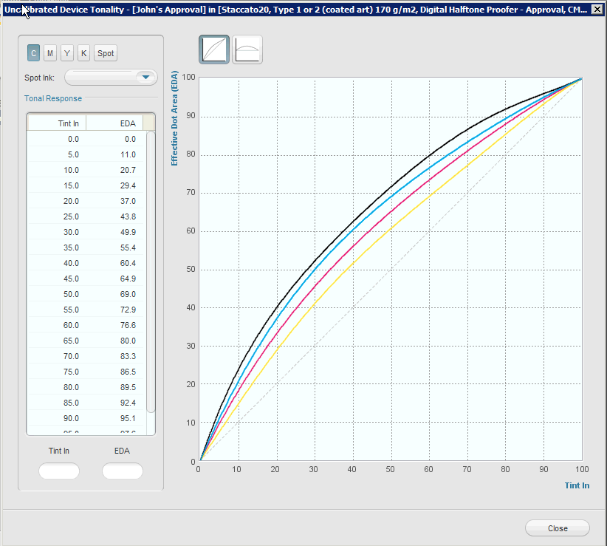
View Response single channel (Uncalibrated Device Tonality)
Before:
0% Cyan change
After:
-5% Cyan @ midtone = +5% Cyan response

Slide 37
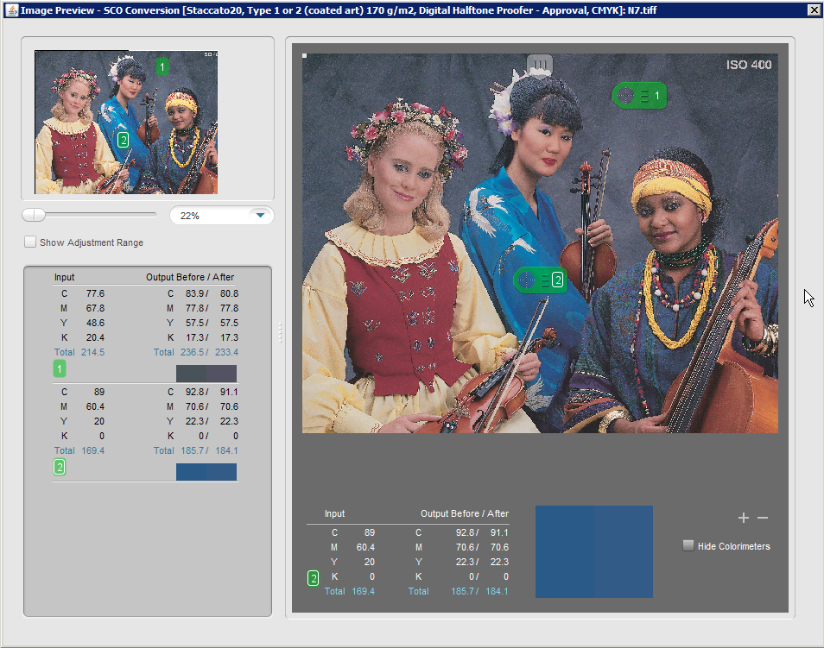
Image Preview – Tiled TIFF Format
Best Practice: Choose an image file or graphic design file that has a good cross-section of colors separated the way “live” content is separated.
Notes:
Mention the colorimeters

Slide 38
Image Preview – colorimeters
Notes:
Mentio

Slide 39

Questions…

Slide 40
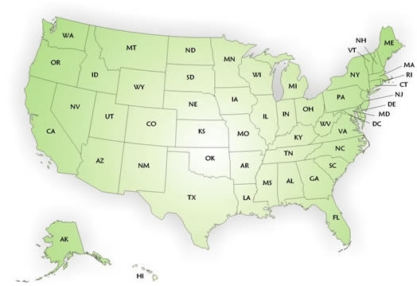

Color Service Contact
  Richard Thies
  c. 617-413-3401
  e. richard.thies@kodak.com

Slide 41

© 2016, Kodak

