Slide 1


ColorFlow Workflow Edition
Print process control for Prinergy Workflow

Slide 2
What is ColorFlow?
A print process control and color relationship management solution, fully integrated with Kodak Prinergy Workflow
Manages Tonal Calibration and Color Relationships
for all print devices in your environment
ColorFlow Workflow Edition creates, edits and manages
Tonal Calibration Curves for print process control
ColorFlow Pro Workflow Edition additionally
manages Color Relationships and Ink Optimization

Slide 3
ColorFlow Workflow Edition Training
Scope: the creation, editing and management
of Tonal Calibration curves for Prinergy Workflow
Intro to Process Control and Industry Standards
ColorFlow User Interface
Creating and managing Plate Curves
Creating and managing Print Curves
  Measuring a printed Characterization chart
  Choosing a Print Reference Target
Generating Reports

Slide 4

Print Process Control

Slide 5
What is Print Process Control?
Ability to measure and control the amount of ink printed for each color, at each tonal level, for each print run
Necessary for consistent, predictable results
Must control each step of the process:
  Platemaking: Plate Curves
  Press Results: Print Curves
Notes:
Predictable means that you expect to get the same results on your press today that you got yesterday.
Predictable means that you can create a proof that adequately represents how the job will print on press.

Slide 6
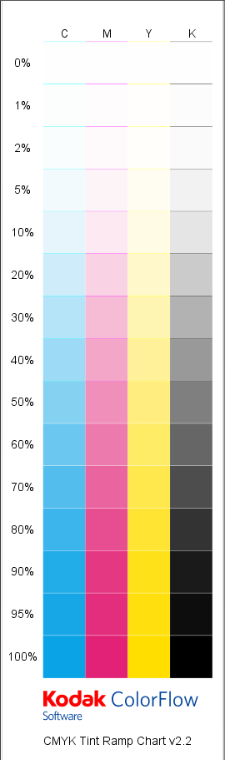
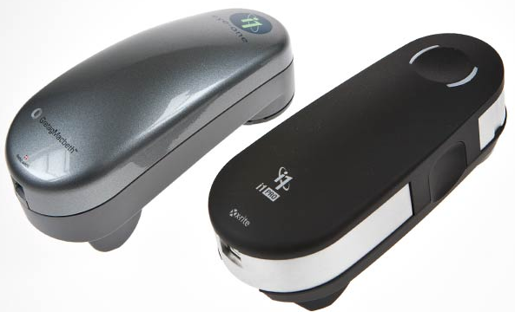
Steps of Process Control
Must be able to maintain a stable print condition
  Consistent Solid Ink Densities and Dot Gain
Print a test target
Measure the printed target
Choose a desired quality target
  Known as a Reference Device Condition
ColorFlow generates Calibration Curves
to match the target condition
Verify print results

Slide 7
Process Control Terminology
Print Density: measurement of light reflected off ink
Dot Gain: halftone dots print darker than requested
  Natural and expected
  Physical gain: liquid ink spreads and increases halftone
  dot size on substrate
  Optical gain: halftone dots absorb light due to light scatter
  in substrate and appear larger
EDA: Effective Dot Area
  Measured* size of a halftone dot expressed as a %
TVI: Tone Value Increase
  Amount halftone dots increase in size due to gain
  Measured as an absolute percentage
  (eg) printed 50% dot that measures 65% has a TVI of 15%
Notes:
Monitoring Print Density and Dot Gain are the two more important quality metrics.
*EDA: halftone dot sizes are not actually directly measured, they are calculated from Density Measurements using the Murray-Davis equation.
Excellent Reference Document: “Xrite Guide to Understanding Graphic Arts densitometry” https://www.xrite.com/documents/literature/en/L7-093_Understand_Dens_en.pdf. Supply to students as a handout? Discusses Murray-Davis equation. Also discusses other aspects of Print Quality Control, such as Apparent Trap, Print Contrast, Hue Error and Grayness values.

Slide 8
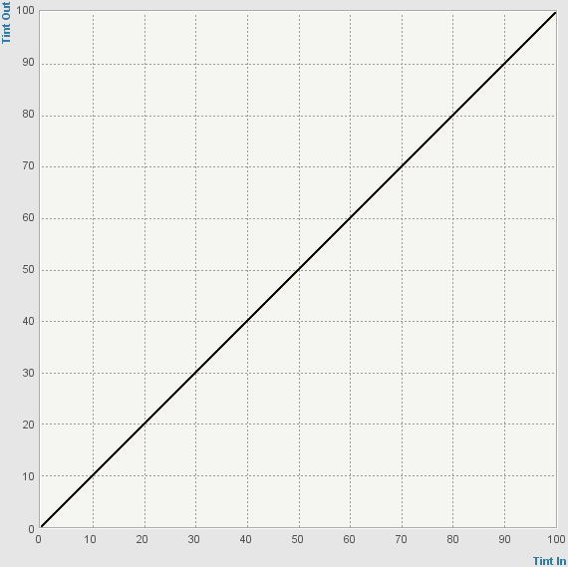
Process Control Terminology (cont’d)
Linear Output: imaged value is the same as the electronic file value (input = output)
Plate Curve: used to adjust plate imaging so plate
is accurate (“linear”)
Print Curve: used to adjust print results to match
a desired target
Notes:
EDA: halftone dot sizes are not actually directly measured, they are calculated from Density Measurements using the Murray-Davis equation.
Excellent Reference Document: “Xrite Guide to Understanding Graphic Arts densitometry” https://www.xrite.com/documents/literature/en/L7-093_Understand_Dens_en.pdf. Supply to students as a handout? Discusses Murray-Davis equation. Also discusses other aspects of Print Quality Control, such as Apparent Trap, Print Contrast, Hue Error and Grayness values.

Slide 9
Dot Gain is Expected and Desirable
Printed results not expected to be linear –
will look washed out if printed that way
Goal is not to eliminate dot gain, just control it
Target print responses are based on desired gain
  Desired mid-tone gain (TVI) is typically between 18-22%
  (resulting in EDA of 68-72%)

Slide 10
Factors affecting Dot Gain
All print factors combine to create a unique
“Device Condition” that must be managed with a
unique set of Tonal Calibration Curves
  Press (offset, letterpress, flexo, screenprinting, digital, etc.)
  Plate (offset, thermal head, UV head, flexographic, etc.)
  Substrate (paper, poly, coated, uncoated, calendered, etc.)
  Inks (chroma, densities, viscosities, grind, etc.)
  Halftone dots (frequency, shape (AM vs stochastic), etc.)
  Other (drying, curing, press speed, humidity, etc.)

Slide 11
Target Print Response
“How you want your device to print”
Shop standard: legacy information or internal specs
(“the numbers from our old RIP” or “the pressman told me to
take 3% out of the Magenta at the mid-tone”)
Industry standard: agreed-upon colorspace description that provides a reference for accurate color reproduction across
different devices and applications
  SWOP (Web offset)
  GRACoL (Commercial Offset Lithography)
  FOGRA (European)
  ISO
  Others… (IFRA, SNAP, JNC, JCW…)
Notes:
SWOP: Specifications for Web Offset Publications (primarily North America), GRACoL: General Requirements for Applications in Commercial Offset Lithography (primarily North America); FOGRA: Fogra Graphic Technology Research Association (primarily Europe)
Excellent guide is IDEAlliance Guide to Print Production 13.0 http://www.idealliance.org/products/guide-print-production-13

Slide 12
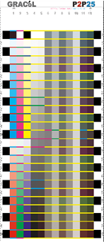
Managing Gray Balance
Eye extremely sensitive to gray casts (reddish, bluish,
or yellowish appearance)
Relative equal amounts of C, M and Y produce gray
Control appearance of gray areas and other colors
will fall into place
Must manage tonality with gray balance in mind
  To “make it lighter” you must remove different amounts of CMY
G7 Gray balance control method used
in latest GRACoL and SWOP standards
  ColorFlow Workflow Edition supports G7
  P2P25 charts for gray balance calibration
Notes:
G7® is Idealliance’s set of specifications for achieving gray balance and achieving visual similarity across all print processes. G7 is a specification and is listed as Technical Report (TR) 015 in ANSI/CGATS. http://www.idealliance.org/specifications/g7

Slide 13
Special Print Conditions and Curves
Some print processes (eg. flexo) have limited ability to print highlight dots
  Said to have “limited highlight resolution”
  Lightest dots have excessive gain and may measure
  10% or more
  Cannot print smooth gradients starting from white
  Known as a “discontinuous” print response
  In ColorFlow, a Flexographic Device is used for discontinuous
  print conditions
  Require special curves to adjust imaged highlights
    Bump Curves: minimum highlights are increased
    Cut-off Curves: minimum highlights are removed
Notes:
Only mention in passing for offset customers. Flexo customers may want to have a discussion on the pros/cons of using Bump Curves vs Cut-off Curves. Flexcel NX customers will also appreciate that Kodak flexo media greatly increases highlight resolution and greatly reduces the need to create bump curves. Also, use of Kodak Maxtone SX Hybrid screening can also eliminate the need to create Bump Curves.

Slide 14

BREAK – 15 minutes

Slide 15
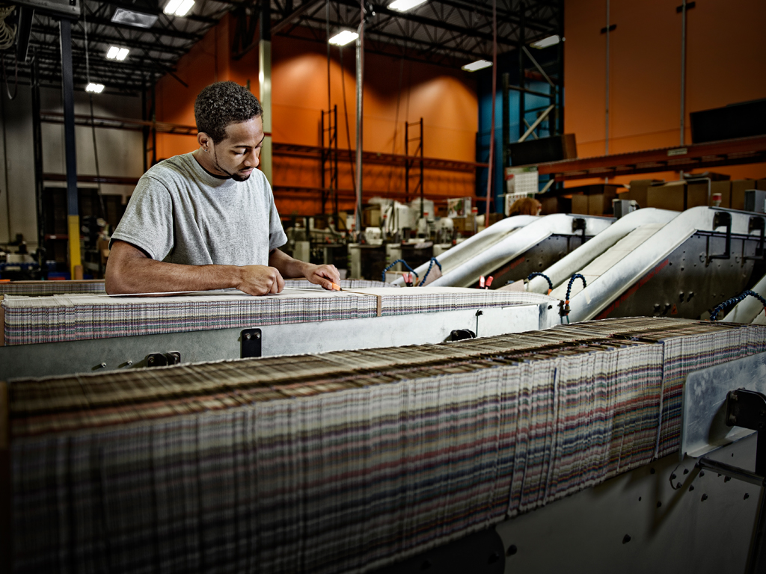
Using ColorFlow WE

Slide 16
ColorFlow Versions
ColorFlow Workflow Edition
  Print Condition Characterization
  Process Control using Tonal Calibration Curves
  Reporting
ColorFlow Pro Edition
  Print Condition Characterization
  Process Control using Tonal Calibration Curves
  Process Control using Color Relationship Management (CRM)
    ICC Device Profiles
    ICC DeviceLink Profiles
  Comprehensive Reporting
  Ink Optimization Solution (Option)

Slide 17
Beyond Workflow Edition…
If time allows, additional ColorFlow Pro capabilities can be introduced at completion of ColorFlow WE training
Color Relationship Management (CRM)
  ColorSetups manage color across all devices in your shop
  ICC Separation Profiles and ICC DeviceLink Profiles
  Comprehensive Print Condition and Verification Reports
  ColorSetups automate CRM within Prinergy: “auto color”

Slide 18
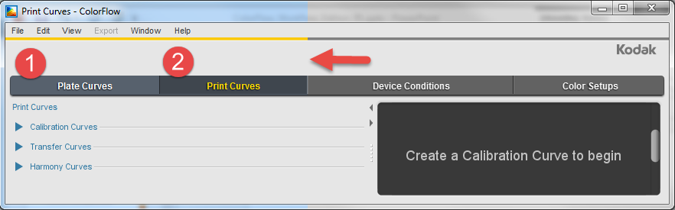
ColorFlow Workflow Edition
Create and manage Calibration Curves for plate and print process control
ColorFlow Workflow Edition only uses Curves tabs
on left side of the user interface
  1. Plate Curves
  2. Print Curves
Notes:
Color Setups and Device Conditions on the right side of the UI are only of concern when doing full Color Relationship Management (CRM).
Ink Optimization is the conversion of color to remove the maximum amount of expensive CMY inks and replace with black (also referred to as Heavy Gray Component Replacement (GCR). Ink optimization also provides greater press stability and renders more detail in images.
Device Conditions and Color Setups relevant only for ColorFlow Pro and full Color Relationship Management (CRM)

Slide 19
Plate Curves
Quick intro to UI
Calibration Curves
  Curve management left
  Properties in right pane
  Image plate target (see below), measure and enter dot %
  Desired Plate Response is always linear
  Important: enable “Show in Prinergy”
Harmony Curves (legacy curve import)
Demo: Create a Plate Calibration Curve
Notes:
Plates are typically measured with Reflection Densitometers. Densitometers are not capable of understanding color, only how much light is reflected off image.
Harmony Curve import. You can select imported Harmony curves for use in ColorFlow, but you can only edit a Derived Curve (Harmony curve with a defined Target and a measured response) after copying it. It’s less work to just create a new Plate calibration curve from scratch). Recommendation: don’t use legacy Plate Calibration curves, create new ones.
Plate Control Strip: example of typical control strip used for calibrating platesetter and linearizing plate output.
PREP: Have a printed proof of a Tint Ramp, and a Tint Set containing only 50% and use a hand-held i1Pro to measure just the 50% values on the Tint Ramp.

Slide 20
Print Curves
Quick intro to UI
Calibration Curves
  The Device Condition targets a Reference Print Condition
  Target (top) linked to Device Condition (bottom)
  Verify?
Transfer Curves
  Use to adjust output based on request (without measured targets)
    First adjust overall response at midtone
    Then adjust highlights, ¼ tones, mids, ¾ tones, shadows
  C3 curves built-in for Flexcel NX media
Harmony Curves (legacy curve import)
Demo: Create a Print Calibration Curve
Demo: Create a Print Transfer Curve
Notes:
Printed charts are read with Spectrophotometers, which are capable of understanding color, not just density.
Transfer Curves – typically used for “shop standards” (doing what the pressman asks for…)
Calibration Curves – used for matching standard reference conditions
Calibration Curve methodology: Print and measure a chart for a new Device Condition
Tint Ramp chart for tonal control
P2P chart for tonal control with gray balance
Device Condition: all print factors which result in a unique print condition. Press, Inks, Substrate, screening, other factors.
“Show Curve in Prinergy” don’t forget curves must be enabled to be visible in Prinergy.

Slide 21
Using Legacy Harmony Curves
No need to edit? Continue to use Harmony Curves “as is”
Need to “mix and match” Harmony and CF curves?
Then must convert to a common curve source (CF)
May have Harmony curves from a consultant (G7)
Plate Curves
  Can only edit “derived” Harmony curves
Print Curves
  Can only edit Transfer Harmony curves
  Not suitable for “node-based editing” (based on table of values)
  Can adjust tonal ranges
Demo: Import Plate Curve, copy Derived Curve for Edit
Demo: Import Print Curve, copy to Transfer
Notes:
If there are no edits required to existing Harmony Curves, there is no value added in importing into ColorFlow. Of course, if you need to “mix and match” Harmony Plate Curves with ColorFlow Calibration Curves (or vice versa), then you will have to migrate the Harmony curves to ColorFlow in order to access from the same Curve Source.
Have a Harmony.hmy set of curves for import. Have both Transfer/Derived Curves for both Plate and Print Curves. (Using

Slide 22

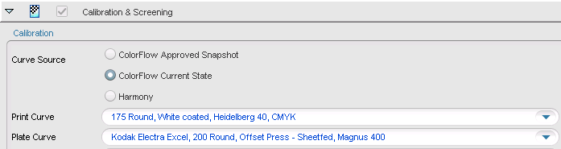
Using ColorFlow curves in Prinergy
In ColorFlow: curves must be enabled for Prinergy
In Prinergy Output Process Templates: choose
relevant Curve Source and select desired curves
from drop-down menus

Slide 23
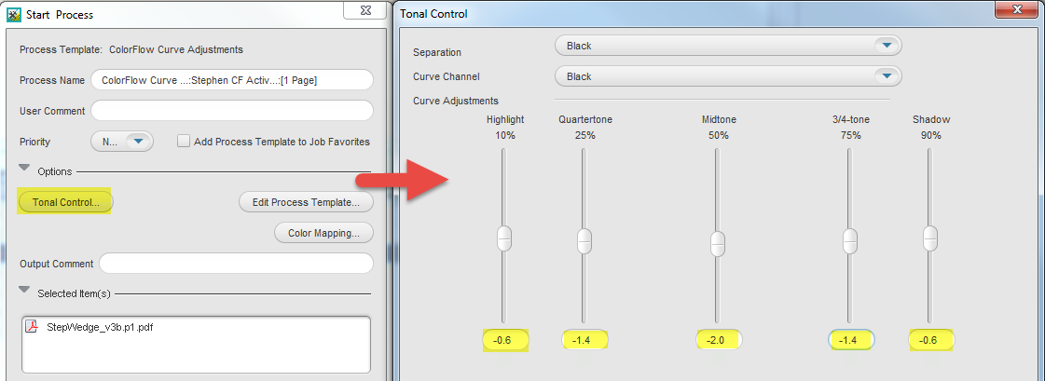
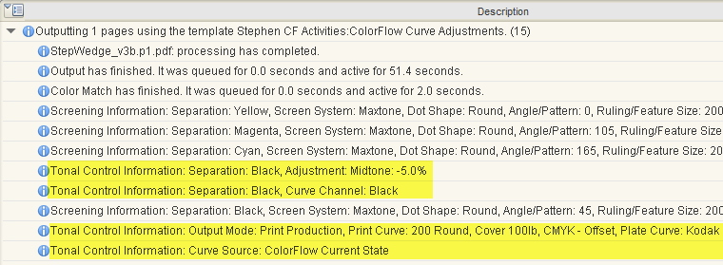
Using ColorFlow curves in Prinergy
ColorFlow curves can adjusted on the fly upon output
Curves/adjustments
reported in Prinergy
Process Info and
History
Notes:
Use the Tonal Control…. Button in Output Process Templates to adjust tonal output on the fly.
Curves used and adjustments applied are recorded in Job History.

Slide 24
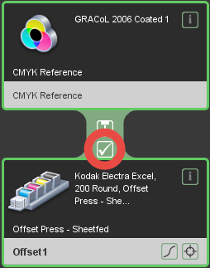
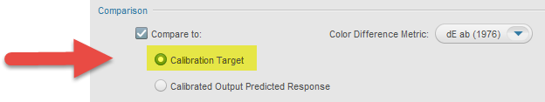
Verification and Reports
Reports useful for monitoring quality control
Generate characterization Report from Measurements
Optional: run a Verification target and Report
  Predicted Color Response: how closely ColorFlow expects to match the selected Calibration Target
  Measured Verification Run: how closely calibrated print condition
  (curves applied) actually matches desired Calibration Target

Slide 25
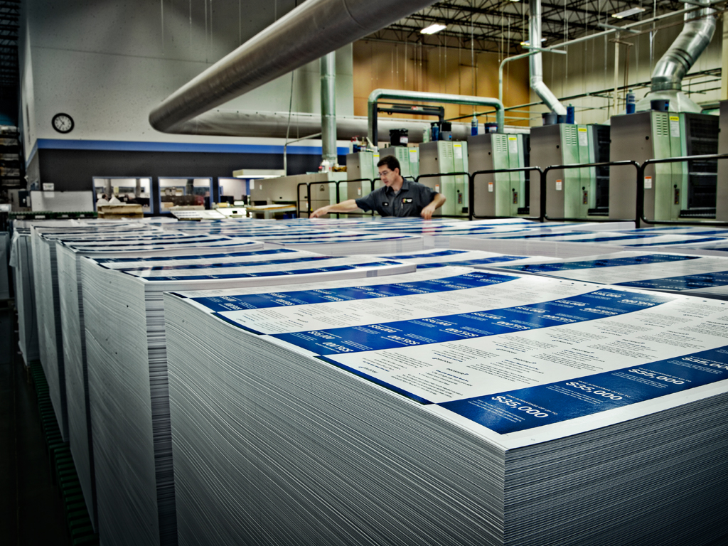
Learning Activities

Slide 26
Learning Activities
Activity 1: Use a plate curve to linearize a plate
Activity 2: Use a transfer curve to control tonal response
Activity 3: Use a transfer curve to control Flexographic print response (for flexographic printers only)
Activity 4: Use a print curve to align a press with an industry specification for tonal match
Activity 5: Use a print curve to match a legacy workflow calibration curve
Activity 6: Use a print curve to align a press with an industry specification for gray balance
Activity 7: Add a spot ink to a print calibration curve
Activity 8: Use Verification reports to verify color response with
a print curve
Notes:
Instructional movies available for some activities:

Slide 27
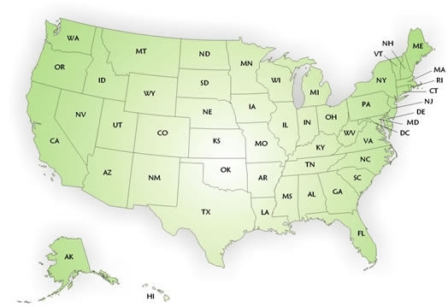

Color Service Contact
  Richard Thies
  c. 617-413-3401
  e. richard.thies@kodak.com

